Slide 1


Healthy Canada by Design (HCBD)
Coalition Linking Action & Science for Prevention (CLASP) Initiative
Presentation at the Atlantic Planning Institute Conference
October 3 2013
Gene Chin, Project Manager
HCBD Hub Website: hcbd-clasp.com
gchin@hsf.ca tel: 604.312.5699

Slide 2

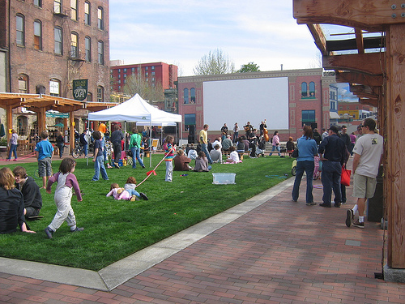
HCBD CLASP Vision Statement
Health officials, planners, engineers and NGOs in communities across Canada collaborate seamlessly to ensure built environments are designed to promote health and well-being, thus contributing to the reduction of risk factors for chronic diseases.
Photo: Amanda Mitchell
hcbd-clasp.com
2

Slide 3










HCBD CLASP 1 - Partners
Four National Organizations
Six Health Authorities
hcbd-clasp.com

Slide 4
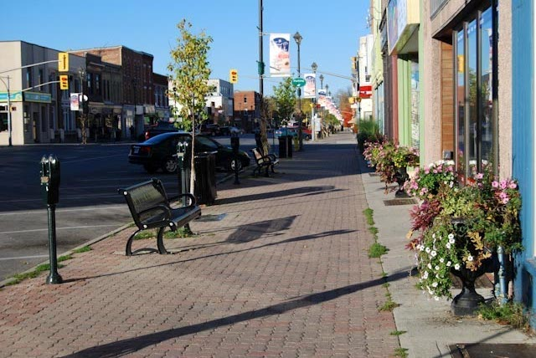
HCBD CLASP1 - Outcomes
  Capacity Building within Health Authorities / Health Regions
  Community of Practice – Knowledge Exchange
  Resources
  Tools
  Photo: K. Perrotta, Kawartha Lakes, Ontario
hcbd-clasp.com
4

Slide 5
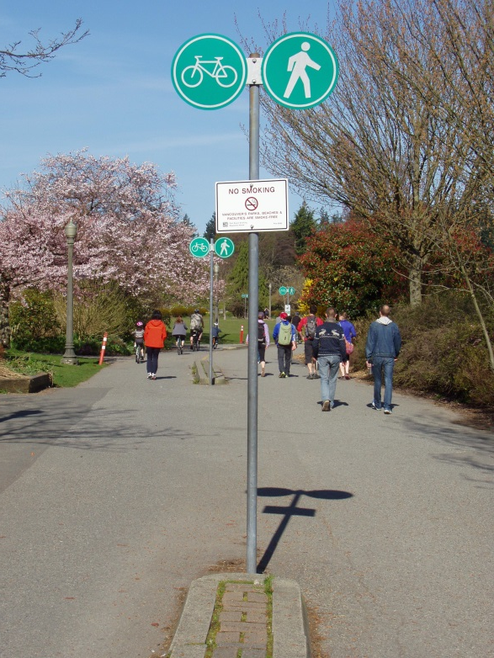
HCBD CLASP1 - Lessons Learned
Collaboration between Public Health, Planners & Engineers needed
  Awareness about links between health & the built environment
  Planners (& Engineers) can lead, but need to bring Public Health in early in the process
  Public Health needs to be clear to Planners & Engineers
Context Is Everything
  Geographic
  Big City vs. Suburbs vs. Small Towns vs. Rural Communities
Gap in information and resources: Rural, Remote, Small & Mid-Sized Communities
Photo: Gene Chin, Vancouver, BC
hcbd-clasp.com
5

Slide 6
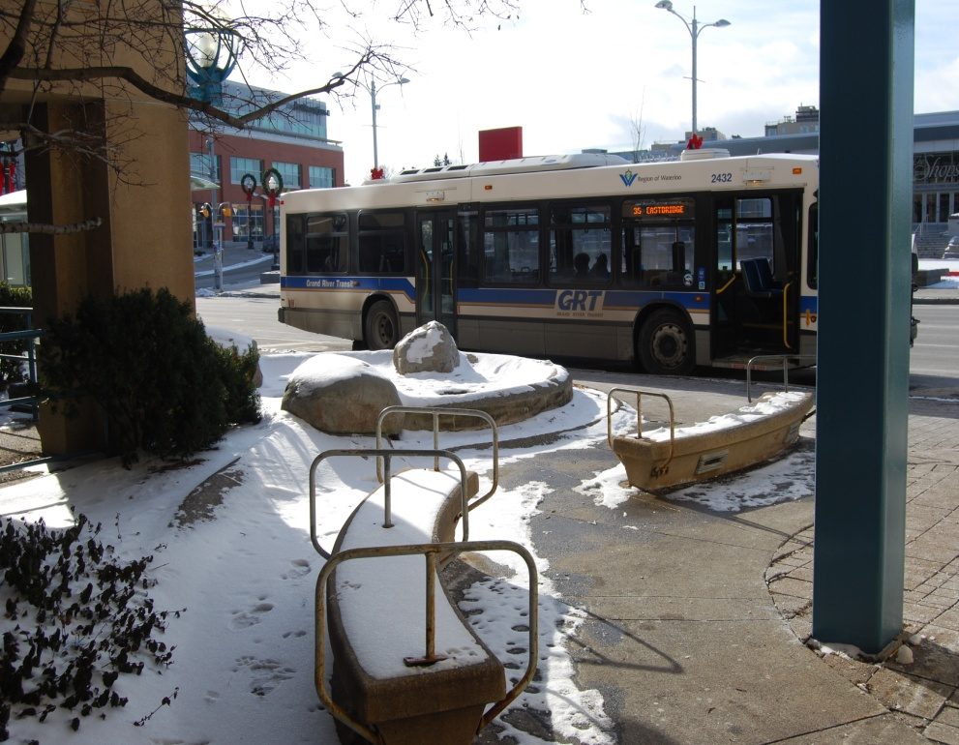
HCBD CLASP1 Renewal - Themes
Deepen the Impact from CLASP1 – build on the projects and lessons learned with existing partners
Broaden the Impact of CLASP1
  apply the tools and resources from CLASP1 into other areas of the country
  ensure that there are projects in rural & mid-sized communities
Photo: K. Perrotta, Waterloo, Ontario
hcbd-clasp.com
6

Slide 7











HCBD CLASP1 Renewal – New Partners
Broadening Impact
Deepen the Impact
Broaden the Impact
Public Health
hcbd-clasp.com
7

Slide 8

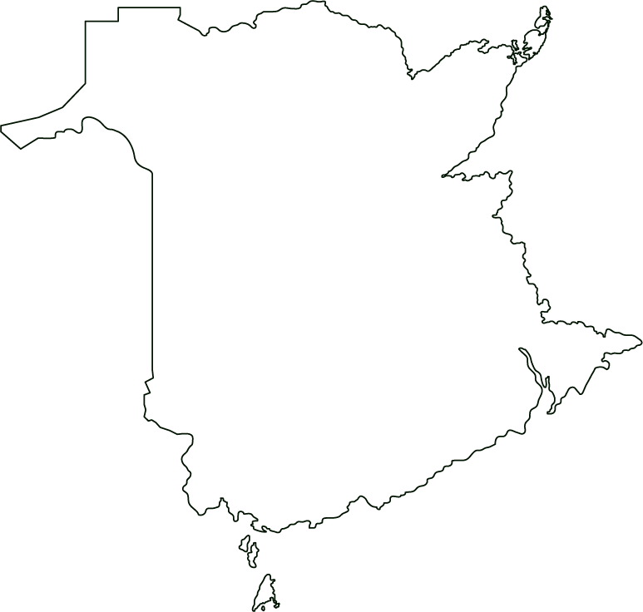
New Brunswick CLASP Project
Creating Healthy Built Environments in New Brunswick
Notes:
My name is Holly McMackin and I’m a planner in Dillon Consulting’s Saint John, NB office. I’m currently working as the facilitator for the CLASP project going on in New Brunswick.

Slide 9



New Brunswick CLASP Project
Who?
Notes:
New Brunswick Department of Health, Office of the Chief Medical Officer of Health (OCMOH) – 2 staff members from their Healthy Environments Branch and two Medical Officers of Health (MOHs)
OCMOH Healthy Environments traditional focus has been on programs that aim at maintaining a healthy environment and at preventing communicable diseases by carrying out inspection, enforcement, licensing and monitoring activities.
My role as facilitator was to help develop and implement the action plan. Use my background as a planner working in NB to help facilitate carrying out the action plan.
Should mention that we are currently about halfway through our process – work began in March this year and will run through until March of next year.

Slide 10

New Brunswick CLASP Project
Raise awareness of linkages b/w built environment and health outcomes
Understand the built environment decision making framework in NB
What?
Strengthen / build relationships with key stakeholders
Develop a model to advance healthy built environment long term
Notes:
Wanted to highlight some of the key goals that we identified for our work:
Raise awareness of linkages – not only within NB Health but also other provincial departments and relevant external stakeholders (municipal decision makers, planners, engineers, etc).
NB Health to better understand the built environment decision making framework in NB
Foster relationships between NB Health staff and other collaborators to create on-going opportunities for cross-sectoral discussions, relationships, learning and knowledge exchange.
ensure that a structure or mechanism is in place to continue work on integrating health considerations into the built environment decisions in NB, once the HCBD CLASP project is completed.

Slide 11

New Brunswick CLASP Project
Healthy Communities Coalition
Working with the City of Fredericton
How?
Community Planning Act Review
RALA Tools Pilot Project

Slide 12

New Brunswick CLASP Project
Rural Active Living Assessement (http://activelivingresearch.org)
Adaptation
RALA
4 Partner Communities
Pilot Project Package
Notes:
Town-wide, programs and policies, street segment
Designed for populations of 10,000 or less
Easy to use
scoring
GOAL – to test pilot RALA tools to see if they are useful, could be rolled out across province
Pilot project package
Stickers for comments
Reporting template
Assess the tools questionnaire
Process
Initial meeting
Carry out work (2-4 weeks)
Meeting #2 to review results, outcomes, process
Council presentation
Status
Initial meetings with each community completed.
Assessments in progress
Second round of meetings and some council meetings scheduled.

Slide 13

New Brunswick CLASP Project
Value in combining the voices of public health and planning
Lessons
Learned
Build the business case; sell the co-benefits
Notes:
Co-benefits
More biking or walking – better air quality, more physical activity which reduces obeisity/diabetes/heart disease
More compact, walkable development patterns save $$ on avoided infrastructure costs and has positive health benefits
Need to get good at articulating the business case or co-benefits depending on your target audience

Slide 14
New Brunswick CLASP Project
Thank You
Holly Owens, MCIP RPP
CLASP Facilitator
Dillon Consulting, Saint John, NB
howens@dillon.ca

Slide 15
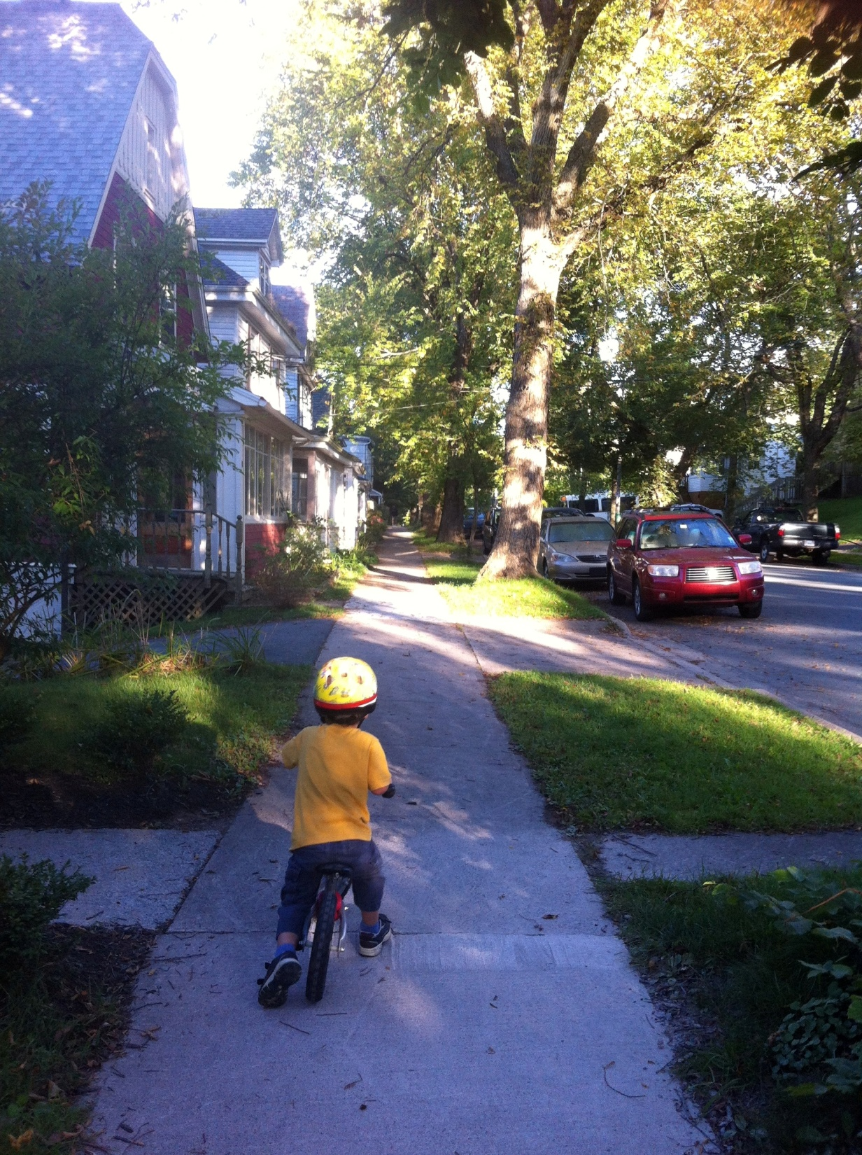
Creating Healthier Communities Together
Dr. Gaynor Watson-Creed, Medical Officer of Health, CDHA
Ali Shaver, CLASP Facilitator
API Conference 2013 - Charlottetown, PEI

Slide 16

What the heck is a medical officer of health (MOH)?

Slide 17

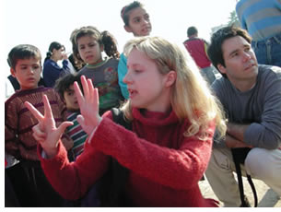
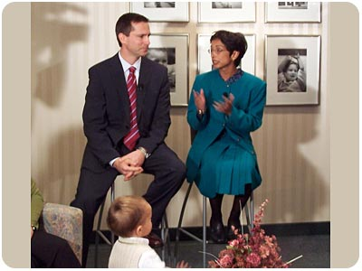
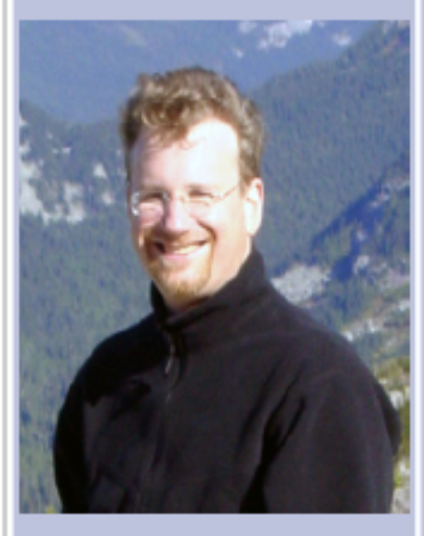

Dr. Eric Hoskins
Dr. Sheela Basrur
Canadians recognize Dr. Marla Shapiro as the Health and Medical Contributor for CTV's Canada AM, and the medical consultant for CTV National News with Lloyd Robertson.
Dr. Samantha Nutt is a medical doctor with more than 13 of experience working in war zones. Committed to peace, human rights and social justice, her ambition has always been to help war-affected women and children. She has worked in some of the world's most violent flashpoints with War Child Canada, the United Nations and non-governmental organizations (NGOs) in Iraq, Afghanistan, The Democratic Republic of Congo, Liberia, Sierra Leone, Somalia, Iraq, Burundi, northern Uganda and the Thai-Burmese border.
IAN SCOTT is Associate Professor and Director, Undergraduate Education, Department of Family Practice at the University of British Columbia. As Director, Dr. Scott is responsible for supporting the training of medical students in all four years of the undergraduate MD Program.
Notes:
Dr. Shapiro completed medical school at McGill University and trained at the University of Toronto for her Masters of Health Science in Community Health and Epidemiology. he trained in Family Medicine and is certified by the Canadian College of Family Practice. She concluded her specialty training in Community Medicine receiving her Fellowship in Community Medicine from the Royal College of Physicians and Surgeons of Canada. She is an Associate Professor in the Department of Family and Community Medicine at the University of Toronto and is in private practice.

Slide 18
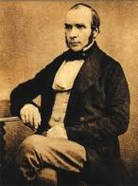
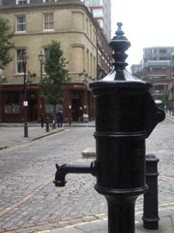
History of Public Health – the emergency of Epidemiology
Seminal event with the Cholera outbreak of 1854 (London): Dr. John Snow
Notes:
In the early 1830s, pandemic cholera spread across Britain and Europe and some physicians had linked cholera and other fevers with impoverished living conditions. They argued that diseases could be prevented if the community took steps to improve the deplorable conditions endured by the poor while others argued that cholera was due to “miasma,” an ill-defined poisonous vapour or mist believed to emanate from rotting organic matter. A potent combination of fear and humanitarianism prompted the British government, for the first time, to establish a temporary national board of health and order town authorities to appoint local boards of health to oversee sanitary improvements. Similar laws were soon enacted in Spain, Germany and France and what would be described as public hygiene or public health was born.
The government of Lower Canada also authorized the establishment of local boards of health in Quebec, Montreal and elsewhere as needed, and appropriated funds for these boards and the costs of quarantine. As approximately 50,000 British immigrants were sailing across the Atlantic Ocean from cholera-infested ports to the Port of Quebec, Lower Canada’s quarantine act was re-invoked and a squad of soldiers was dispatched to Grosse Isle.
Sanitary reform, as it was known, became the stuff of many acts of legislation in Europe and Canada, and before long public health acts were emerging in response to issues such as these. The roots of the issues in poverty were well understood and documented.

Slide 19
COMMUNITY
ACUTE CARE STRUCTURES
municipalities
school boards
Primordial Prevention: preventing the risk factors from even occuring
Primary Prevention:
Preventing disease through modifying existing risk factors
Secondary Prevention:
Early detection and treatment of disease
police
community services
Tertiary Prevention:
preventing the worst outcomes from the disease (death/dismemberment/disability)
planning departments
Public Health
Primary care/Public Health
Outpatient clinics/services
Specialists

Slide 20
Public Health works with others to understand
the health of our communities, and acts together to improve health.

Slide 21
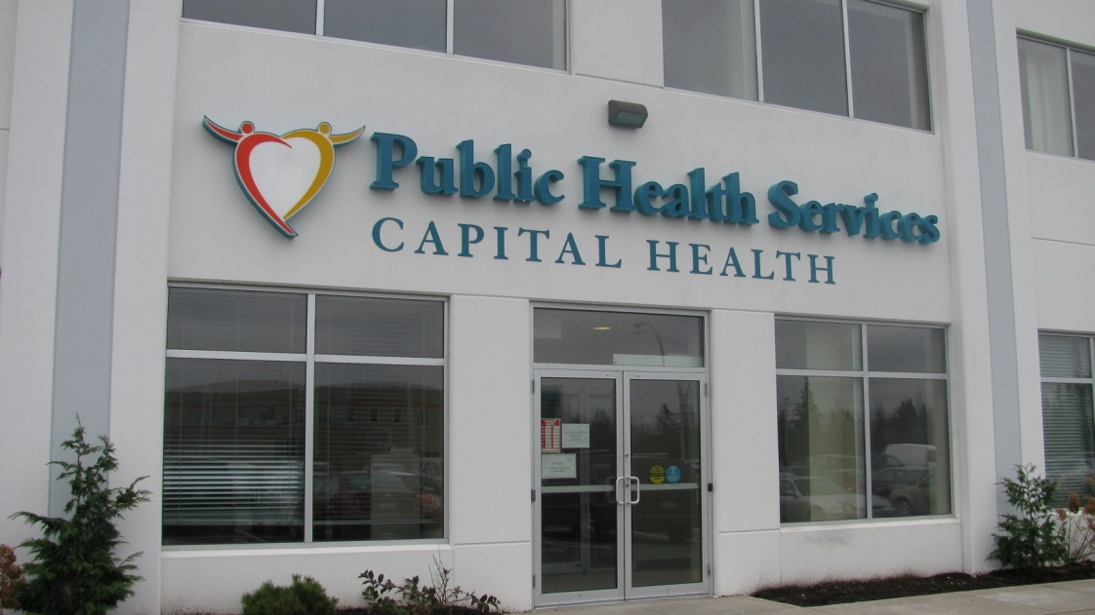
Local Public Health is based in District Office (1 of 9):
7 Mellor Avenue, Burnside Industrial Park
120 staff, 3-4 multidisciplinary teams
Director: Linda Young

Slide 22
Our Local CLASP-HCBD Project

Slide 23
Our Goals
To build sustainable working relationships and process for collaboration between HRM Planning and Public Health Services.
To build capacity within Public Health Services to engage in healthy built environment work.
To create a better understanding among Municipal Planners + Public Health Staff about the mutual benefits achieved through working together.

Slide 24
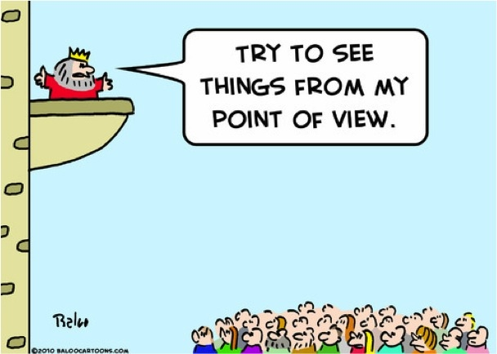
Our Approach

Slide 25
Project Governance
Advisory Committee
  HRM: Manager of Planning, Manager of Strategic Transportation, Engagement Lead
  PHS: MOHs, Manager
  CEU / Dal: Director + Faculty
  Heart and Stroke Foundation of Nova Scotia: Director
Technical Committee
  HRM: TDM Coordinator, Cultural Planner, Planner
  PHS: Nutritionist, Research + Statistics Officer, Health Educator
  CEU / Dal: Planners (3)

Slide 26
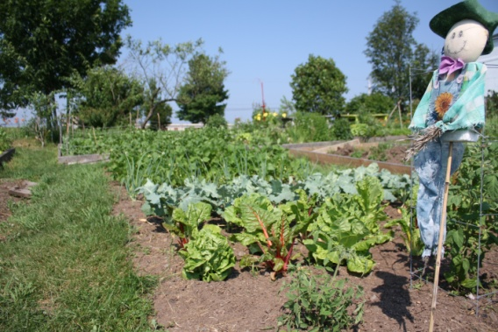

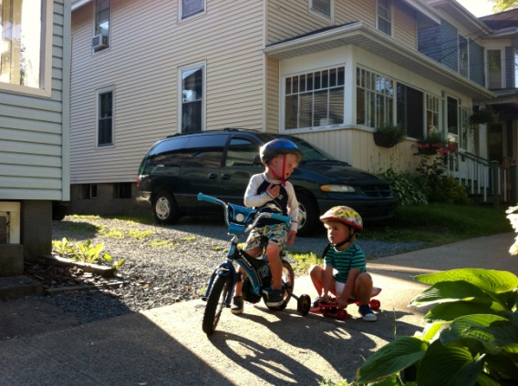
Community Design Standards
Research and propose Community Design Standards for suburban developments in HRM.
Healthy Development Index (HDI)
  Density
  Mix of uses
  Service proximity
  Street connectivity
  Road network + sidewalk characteristics
  Parking
  Aesthetics + human scale
For more information see:
http://hcbd-clasp.com/clasp-i-resources-tools

Slide 27
Municipal Food Strategy
Develop tools that help HRM engage in conversations about the food system + food security.
  Community food assessment
  Food Charter (vision)
  Food Strategy (action)
For more information: MacRae, R and K. Donahue (2013). Municipal Food Policy Entrepreneurs: An Analysis of How Canadian Cities and Regional Districts are Involved in Food System Change.

Slide 28
Complete Streets Policy
Develop a Complete Streets Policy
  Research promising practices from other places.
  Understand current situation within HRM.
  Build internal consensus.
  Build community support for the policy.
  Implement the policy (start with a pilot project).
For Canadian policy examples see City of Edmonton, Town of Ajax, Region of Waterloo and the Niagara Region (under development).

Slide 29




Other Plans + Initiatives…

Slide 30
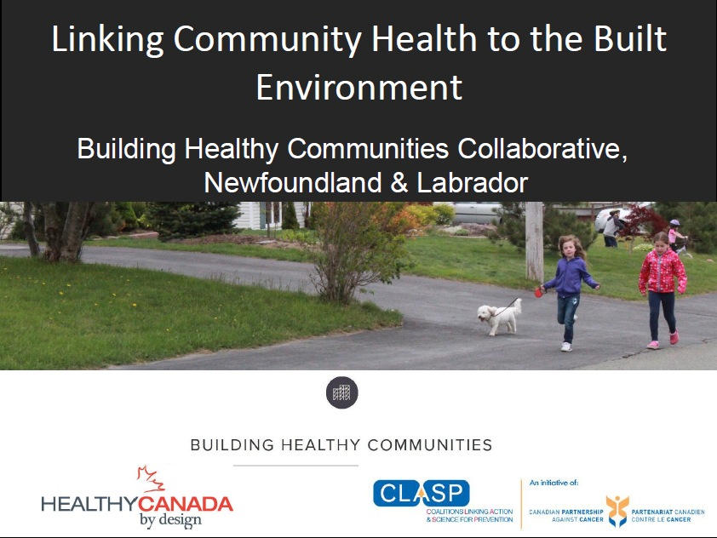

Slide 31
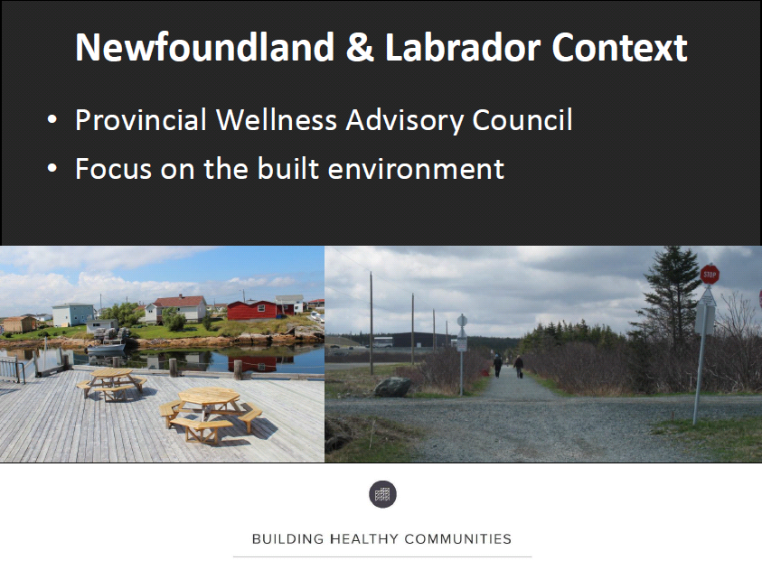

Slide 32
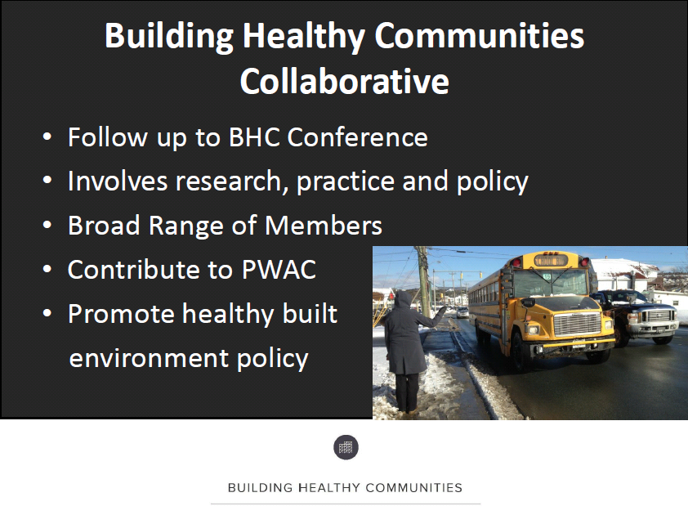

Slide 33
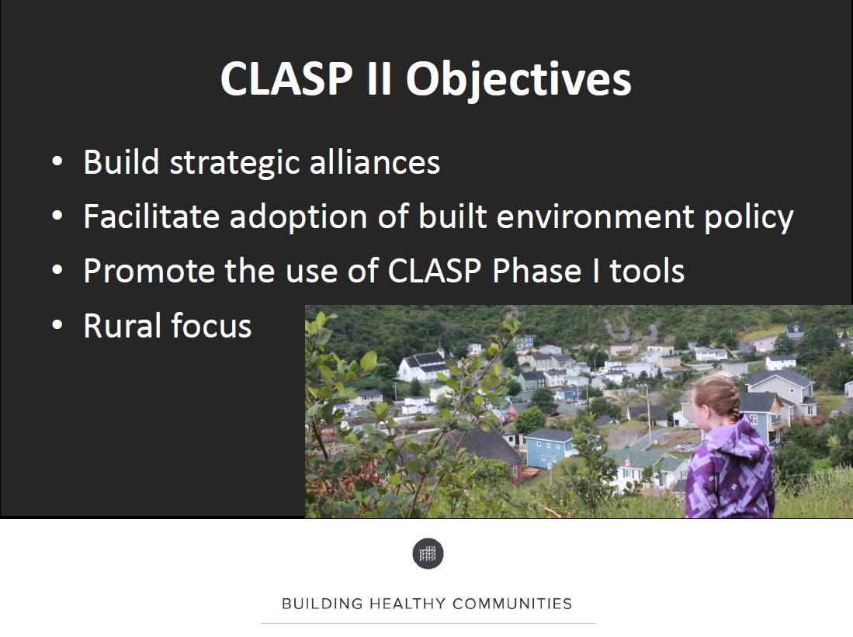

Slide 34
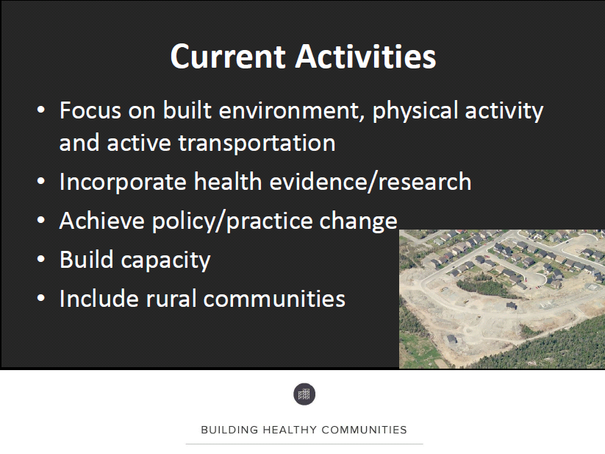

Slide 35
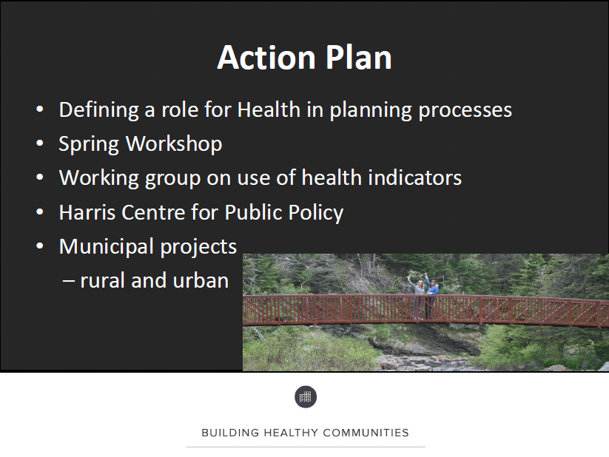

Slide 36
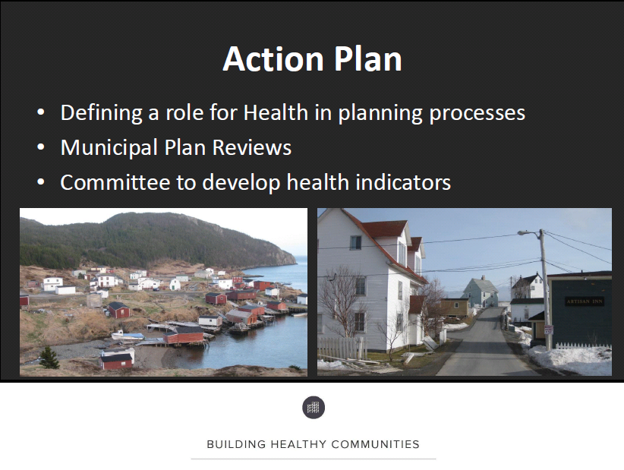

Slide 37
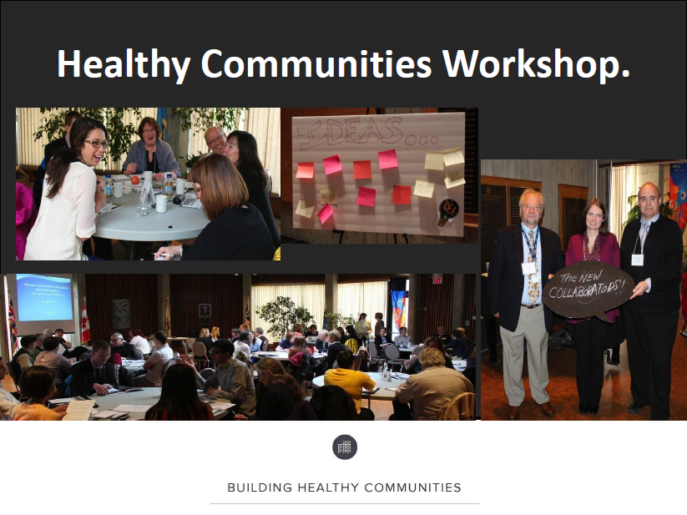

Slide 38
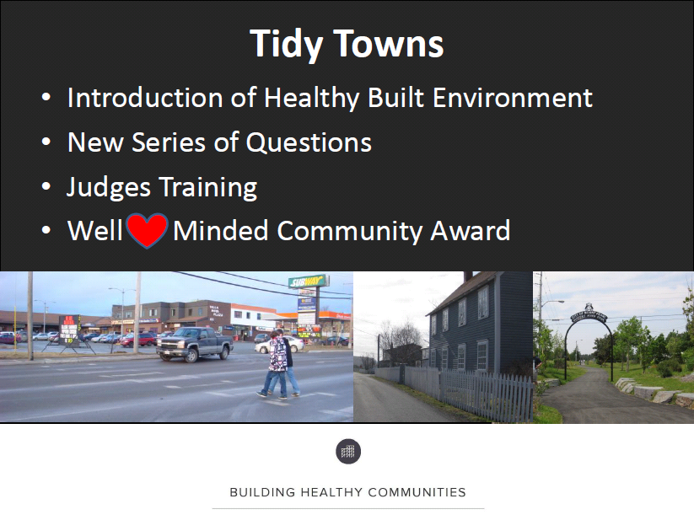

Slide 39
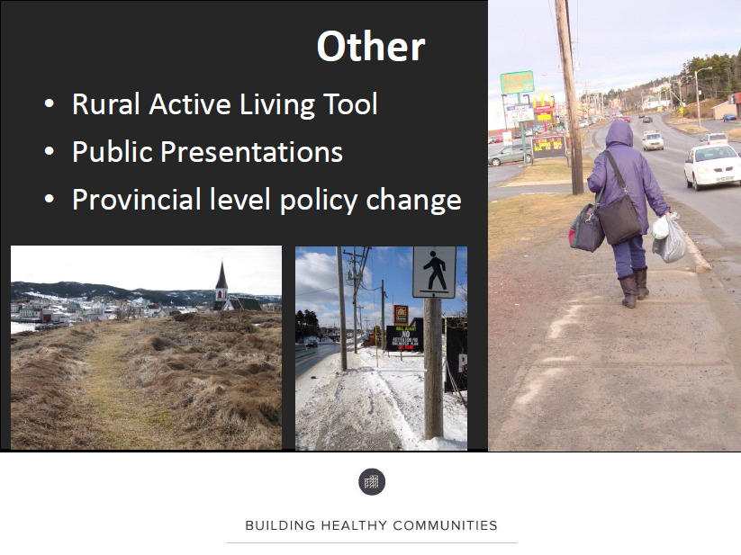

Slide 40
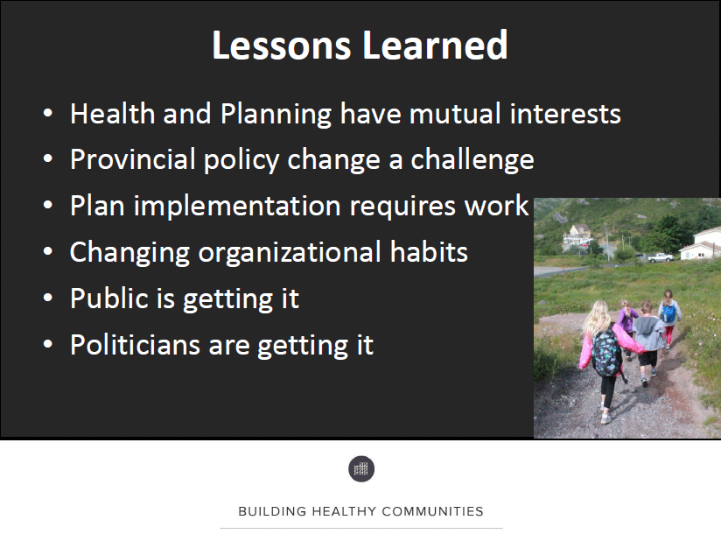

Slide 41
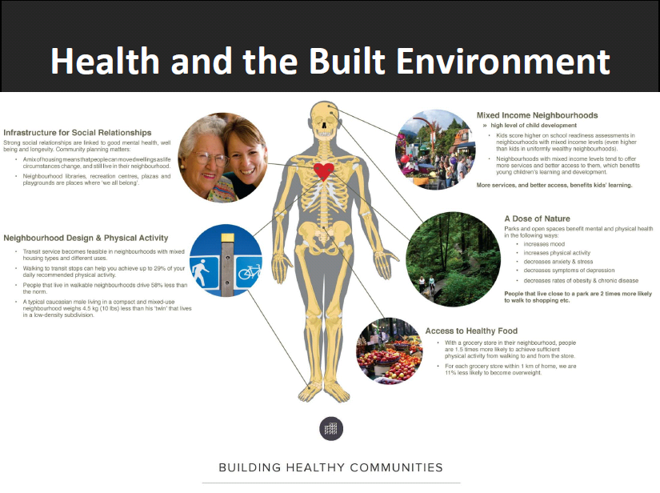

Slide 42
