Slide 1
Global Change and Public Health: Addressing the Ecological Determinants of Health
Panelist Discussion
CPHA Conference
June 11th, 2013

Slide 2

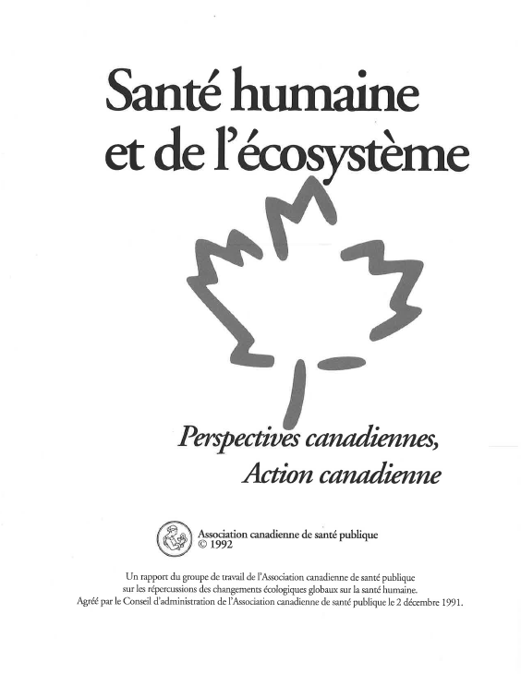
Background
Speaker: Jim Chauvin
  Update of 1992 Position Paper

Slide 3
Overview of Work to Date
Speaker: Jim Chauvin
  Position Paper
  First Amalgamated Draft completed
  Final version completed in Fall 2013
  Approve and publish in January 2014
  Audience: Public Health Professionals and organizations , other health professionals, policy developers, politicians, partner organizations and the concerned general public.

Slide 4
Goals of the Paper
Speaker: Jim Chauvin
Promote EDH approach
Outline scientific evidence
Address growing health inequity
Provide plausible alternatives
Provide tools for practitioners
Provide actions for organizations

Slide 5
Introduction
Speaker: Jim Chauvin
Six Main Sections:
  Ecosystems and Human Health
  The State of the Earth’s Ecosystems
  The Societal Forces Driving Change
  Implications for Population Health
  An Alternative, More Positive Future
  The Role of Public Health
  Also a Communications and Outreach Piece

Slide 6
Presenters
Speaker: Jim Chauvin
Part 1: Overview of the report
Ecosystems and Human Health and
The State of the Earth’s Ecosystems –Trevor Hancock
The Societal Forces Driving Change – Margot Parkes
Implications for Population Health – Colin Soskolne
An Alternative, More Positive Future – George McKibbon
Communications and Outreach – Mitchell Beer
Part 2: Input from you

Slide 7
Scope of Paper
Speaker: Trevor Hancock
This Paper is…
  A succinct summary
  Practitioner driven
  A tentative guide
This Paper is not…
A comprehensive report
Politically driven
A definitive solution

Slide 8
Purpose of Panelist Session
Speaker: Trevor Hancock
Presentation of current content
Audience driven discussion
Focus on development of ‘Action Items’

Slide 9
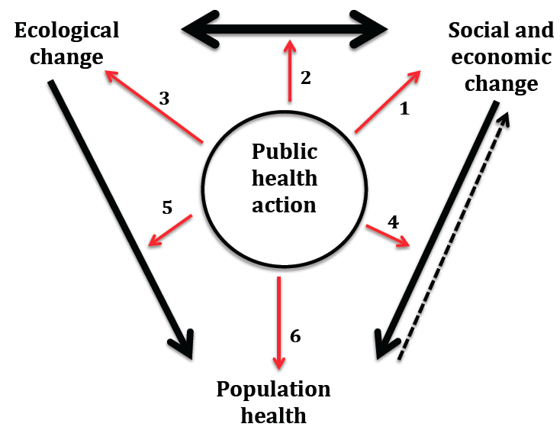
Socio-Ecological Model for Public Health Action
Speaker: Trevor Hancock

Slide 10
Speaker: Trevor Hancock
PART 1:
Ecosystem and Human Health

Slide 11
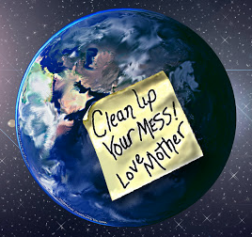
PART 1: Ecosystems and Human Health
Speaker: Trevor Hancock
NATURE VS. HUMAN NATURE:
  The earth as our Mother
  Humans as a form of cancer
  Imbalance

Slide 12
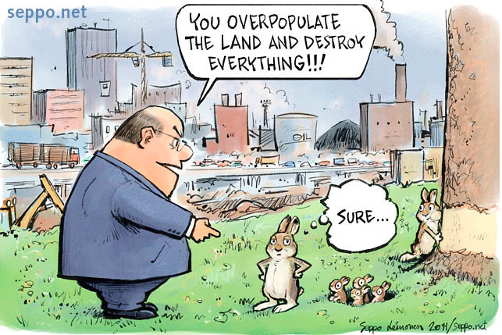
PART 1: Ecosystems and Human Health
Speaker: Trevor Hancock
Changing Attitudes
  Separation from Nature
  Dominance of Humans
  Fear of Nature

Slide 13
PART 1: Ecosystems and Human Health
Speaker: Trevor Hancock
Understanding Ecosystems
"Earth is a live planet that regulates its surface and atmosphere in the interests of its biosphere."
Aldo Leopald~
  Biophilia
  Stability
  Ecotoxicity & BioConcentration

Slide 14
Speaker: Trevor Hancock
PART 2:
The State of the Earth’s Ecosystems

Slide 15
PART 2: The State of the Earth’s Ecosystems
Speaker: Trevor Hancock
Nine Earth System Processes: (Rockstrom et Al)
Climate Change
Loss of Biodiversity
Nitrogen & Phosphorus Cycle
Ozone Depletion
Ocean acidification
Global freshwater use
Changes in land use
Chemical Pollution
Atmospheric aerosol loading

Slide 16
Major ecological determinants
Speaker: Trevor Hancock
Climate and atmospheric change
  Climate change
  Ozone depletion
  Acid emissions
Pollution and ecotoxicity
  POPs
  Air, water and soil pollution
Resource depletion
  Renewable
  Non-renewable
Loss of species
Loss of ecosystem functions

Slide 17
PART 2: The State of the Earth’s Ecosystems
Speaker: Trevor Hancock
Marginally Critical
Close to Critical
Critical
Boundaries
Global freshwater use
Changes in land use
Phosphorus Cycle
Ozone Depletion
Ocean acidification
Climate Change
Loss of Biodiversity
Nitrogen Cycle

Slide 18
PART 2: The State of the Earth’s Ecosystems
Speaker: Trevor Hancock
Climate Change 1992 2012
CO2
22.6 Billion Tonnes
33.9 Billion Tonnes
Average Temp
14.15°C
14.53°C
Arctic Summer Ice
49% Below Long Term Average (2012)

Slide 19
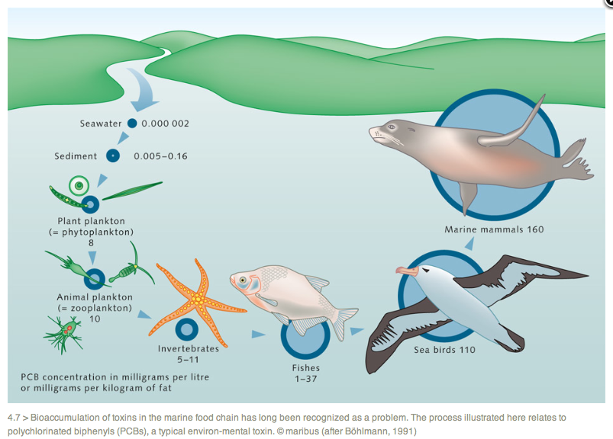
PART 2: The State of the Earth’s Ecosystems
Speaker: Trevor Hancock
Pollution and Ecotoxicity
Increase in PCB concentration from water to seal is 80,000,000 times

Slide 20
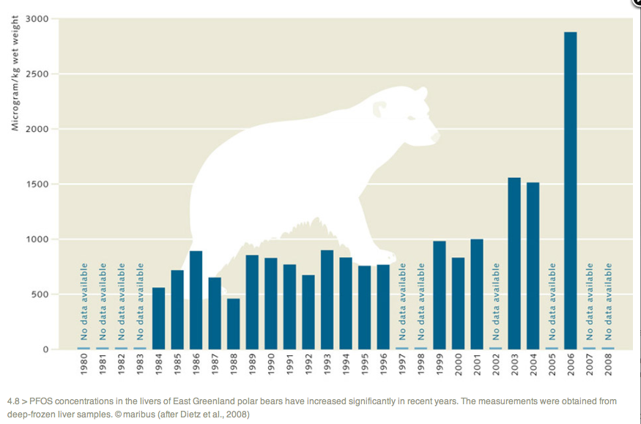
PART 2: The State of the Earth’s Ecosystems
Speaker: Trevor Hancock
Pollution and Ecotoxicity – PFOS in polar bear liver
Perfluoro-octane sulfonate levels in ppb
"PFOS is persistent, bioaccumulative and toxic to mammalian species.” - Environmental Directorate of the OECD, 2002
Notes:
Perfluorooctanesulfonic acid or perfluorooctane sulfonate (PFOS), is a man-made fluorosurfactant and global pollutant. PFOS was the key ingredient in Scotchgard, a fabric protector made by 3M, and numerous stain repellents. It was added to Annex B of the Stockholm Convention on Persistent Organic Pollutants in May 2009.^{[4]} PFOS can form from the degradation of precursors in addition to industrial production. The PFOS levels that have been detected in wildlife are considered high enough to affect health parameters, and recently higher serum levels of PFOS were found to be associated with increased risk of chronic kidney disease in the general United States population, consistent with earlier animal studies.^{[5]} "This association was independent of confounders such as age, sex, race/ethnicity, body mass index, diabetes, hypertension, and serum cholesterol level."^{[5]}
In 1949, 3M began producing PFOS-based compounds by electrochemical fluorination resulting in the synthetic precursor perfluorooctane sulfonyl fluoride.^{[6]} In 1968, organofluorine content was detected in the blood serum of consumers, and in 1976 it was suggested to be PFOA or a related compound such as PFOS.^{[7][8][9]} In 1997, 3M detected PFOS in blood from global blood banks.^{[10]} In 1999, the U.S. Environmental Protection Agency began investigating perfluorinated compounds after receiving data on the global distribution and toxicity of PFOS, the key ingredient in Scotchgard.^{[11]} For these reasons, and USEPA pressure,^{[12]} the primary American producer of PFOS, 3M, announced, in May 2000, the phaseout of the production of PFOS, PFOA, and PFOS-related products.^{[13]} PFOS and PFOS-related chemicals are currently produced in China.(Wikipedia)

Slide 21
PART 2: The State of the Earth’s Ecosystems
Speaker: Trevor Hancock
Depletion of Renewable and Non-Renewable Resources 1990 2007
Global Ecological Footprint
2.7 Hectares
(Pop 5.3 Bill)
2.7 Hectares
(Pop 6.7 Bill)
Biocapacity Ratio
1.18
1.51
Global US consumption Patterns
Would require 2-3 planets (2007)

Slide 22
PART 2: The State of the Earth’s Ecosystems
Speaker: Trevor Hancock
Loss of Habitat, Species, and Diversity
1992 2007
GLPI
0.72
Tropical LPI
0.55
0.4
Temperate LPI
1.22
1.29
0.82

Slide 23
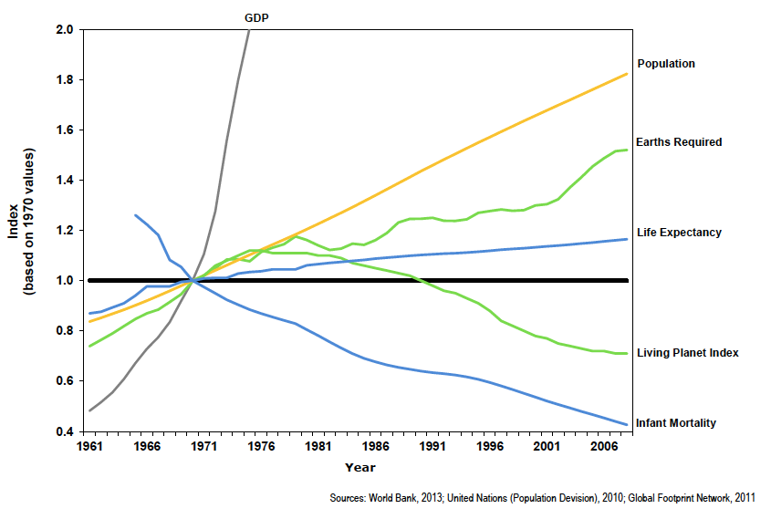
PART 2: The State of the Earth’s Ecosystems
Speaker: Trevor Hancock
Trends of Indices Related to Population Health
- Daniel Rainham

Slide 24
Speaker: Margot Parkes
PART 3:
Societal Forces Driving Change

Slide 25
PART 3: Societal Forces Driving Change
Speaker: Margot Parkes
Four Main Categories
  Population Growth
  Economic Growth and Development
  Technological Advances
  Social Changes

Slide 26
PART 3: Societal Forces Driving Change
Speaker: Margot Parkes
Population Growth Over the Past 20 Years (UNEP 2011)
Population Growth
Urban Growth
Mega Cities
Doubled to 21
5.5 Billion to
7 Billion
50% Live in Cities
Population in Slums
Risen to 825 Million

Slide 27
PART 3: Societal Forces Driving Change
Speaker: Margot Parkes
Economic Growth Over the Past 20 Years (UNEP 2011)
International Trade
GDP
Global Materials Extraction
41% Increase
$9 Trillion to
$28 Trillion
75% Increase
Food Production
45% Increase

Slide 28
PART 3: Societal Forces Driving Change
Speaker: Margot Parkes
A Note on Economic Growth
  The concept of ‘doubling’/’halving’ times:
  3% Economic Growth per year
  = Doubling time of 23 years
  80 year lifespan = 10.6 x current resources

Slide 29
PART 3: Societal Forces Driving Change
Speaker: Margot Parkes
Technological Advancement Over the Past 20 Years (UNEP 2011)
Cell Phone Use
Internet Use
Air Transport
Air Passenger: 100% Increase
Freight: 230% Increase
23000% Increase
29000% Increase
Plastic Production
130% Increase

Slide 30
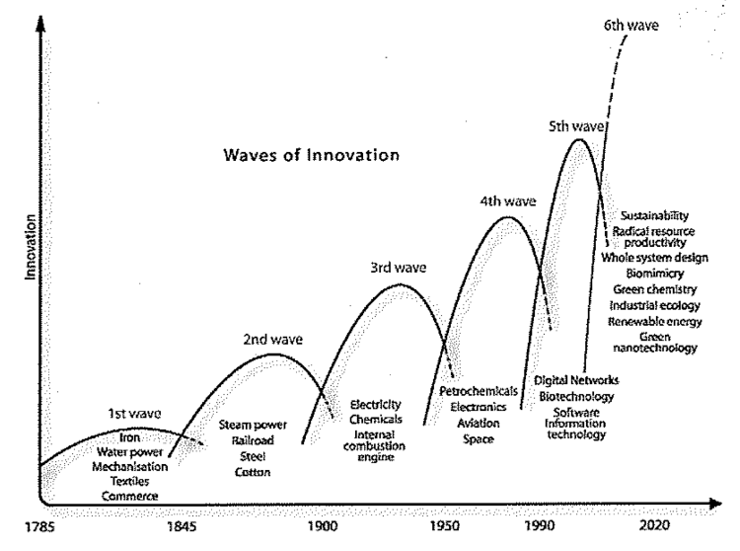
PART 3: Societal Forces Driving Change
Speaker: Margot Parkes
A Note on Technological Innovation:

Slide 31
PART 3: Societal Forces Driving Change
Speaker: Margot Parkes
Social Changes Over the Past 20 Years:
Inequity
Gender
Facebook
800 Million Users
100 Wealthiest Families could end poverty
Women overtaken men in Postsecondary Enrollment (Canada)

Slide 32
PART 3: Societal Forces Driving Change
Speaker: Margot Parkes
Changing Values:
  Per John Last (+ related discussions….)
  Recognize a problem (or opportunity) exists
  Identify causes (or drivers of change/values)
  Capacity to control causes (enhance +tive change)
  Sense of values that it is worthwhile/impt to act
  Political will (including ‘governance’ shifts)

Slide 33
PART 3: Societal Forces Driving Change
Speaker: Margot Parkes
Potential transformation points (Silver Linings?)
  A view of environment as a living system
  Ecological literacy: global – regional – local
  Returning to social-ecological context for health
  Linking social and ecological change
  Shift to green: Industry, Car-less, paper-less
  Linking with justice: Just, sustainable, healthy

Slide 34
Speaker: Colin Soskolne
PART 4:
The Implications for Population Health

Slide 35
The CPHA Working Group is asking
Speaker: Colin Soskolne
PART 4: The Implications for Population Health
“What control do we have over the ecological determinants of health, and how will changes in these affect our health? Have we so separated ourselves from nature that the disconnect that relies so heavily on technological solutions to save us from ourselves can be relied upon?”

Slide 36
Speaker: Colin Soskolne
PART 4: The Implications for Population Health
The primary factors that shape the health of Canadians are not medical treatments or lifestyle choices, but rather the living conditions they experience, including income and wealth distribution, employment, health and social services, education, food and housing. These conditions have come to be known as the social determinants of health. Under this framework, the ecological determinants, which are the upstream determinants of all that sustains life on Earth are not recognized at all. What are the ecological determinants of health?

Slide 37
PART 4: The Implications for Population Health
Speaker: Colin Soskolne
Global Geoclimatic System Changes
Higher Mean Global Temperatures
Increased heat Deaths
Increased waterborne, foodborne, and vectorborne illness
Sea Level Rise
Inundation: Eco-refugees
Wider Distribution of Insects
Drought, desertification and flooding
Increase in malaria, dengue, lyme disease etc…
Crop failure
Ecosystem Changes
Extreme Weather Events
Food security
Social disruption and disasters

Slide 38
PART 4: The Implications for Population Health
Speaker: Colin Soskolne
Ozone Layer Depletion
Increased UV Radiation
Skin cancer
Cataracts
Acid Emissions
Ocean and freshwater acidification
Loss of key aquatic life
Damage to coral reefs
Soil acidification
Agricultural and forest productivity

Slide 39
PART 4: The Implications for Population Health
Speaker: Colin Soskolne
Ecotoxicity
POPs
Human and animal health
Heavy Metals
Human and animal health
Endocrine Disruption
Human and animal health
Biodiversity

Slide 40
PART 4: The Implications for Population Health
Speaker: Colin Soskolne
Resource Depletion
Water
Drought
Oil
Energy Crisis
Fisheries
Topsoil and flood lands
Hunger
Food insecurity
Forests
Minerals
Flooding
Less nutritional foods
Conflict
Conflict
Conflict
Loss of Carbon Sinks,

Slide 41
PART 4: The Implications for Population Health
Speaker: Colin Soskolne
Loss of Species and Biodiversity
Crop Monoculture
Hunger
Loss of Medically Valuable species
Fewer medicinals
Weakened Web of Life
Decline in nature’s services
Loss of resiliency/imbalance
Waste disposal

Slide 42
Speaker: George McKibbon
PART 5:
An Alternative, More Positive Future…

Slide 43
PART 5: An Alternative, More Positive Future
Speaker: George McKibbon
Three Scenarios:
  Scenario 1: Business as usual: ‘doing the same things’
  Scenario 2: Risk management: ‘doing the same things better’
  Scenario 3: Transition: ‘doing better things’

Slide 44
PART 5: An Alternative, More Positive Future
Speaker: George McKibbon
Scenario 1: Business as usual
  Increasing Social Inequality
  Reliance on Technological Solutions
  Declining Global Economy
  Faltering Public Health Systems

Slide 45
PART 5: An Alternative, More Positive Future
Speaker: George McKibbon
Scenario 2: Risk Management
  Governmental and intersectoral collaboration
  New monitoring, regulation, and evaluation
  Social inequity focus
  Only incremental change

Slide 46
PART 5: An Alternative, More Positive Future
Speaker: George McKibbon
Scenario 3: Transition
  Abandonment of economic growth model
  Integration and intersectoral engagement
  Synergy of community development, social justice, and ecological harmony
  Attention to ‘place’

Slide 47
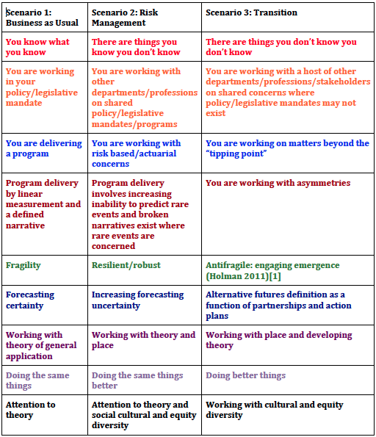
PART 5: An Alternative, More Positive Future
Speaker: George McKibbon
Characteristics of the three scenarios:
Taleb, Nassim Nicholas.
(2012), Antifragile: Things
That Gain from Disorder, Random House, New York.
Rumsfeld, Donald (2002)
Slavoj Žižek (2009)

Slide 48
PART 5: An Alternative, More Positive Future
Speaker: George McKibbon
Reflection:
  Three scenarios based on existing movements
  Importance of integration/communications
  Relevance of aboriginal values/attention to ‘place’
  Precedents at all levels

Slide 49
Speaker: Trevor Hancock
PART 6:
The Role of Public Health
We will come back to this…

Slide 50
Speaker: Mitchell Beer
Communications and Outreach

Slide 51
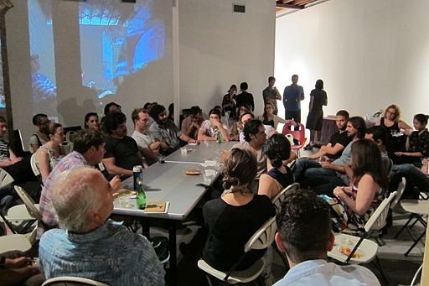
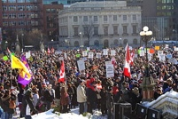
Communications and Outreach
Speaker: Mitchell Beer
  Reaching out to public health professionals:
  As a direct audience to
  build recognition of the
  ecological determinants of
  health
  As community leaders
  with the ability to
    Raise public
    awareness
    Build momentum
    for local action
    Photo: Locust Projects via Wikimedia
    Photo: Michelle Tribe via Wikimedia

Slide 52

Communications and Outreach
Speaker: Mitchell Beer
  The point of reference: Frontline Health

Slide 53
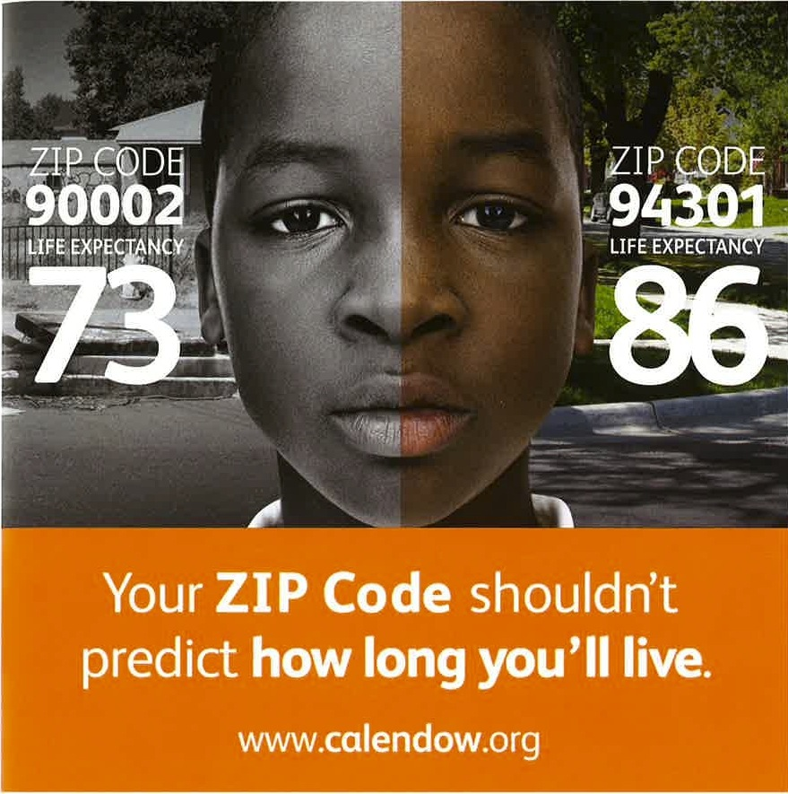
Communications and Outreach
Speaker: Mitchell Beer
  The point of reference: Frontline Health
    California Endowment

Slide 54
Communications and Outreach
Speaker: Mitchell Beer
  Basic campaign elements
  Website
  Social media release for Working Group report
    Twitter
    Facebook
    Blog as the fulcrum
  Opinion leader campaign

Slide 55
Communications and Outreach
Speaker: Mitchell Beer
  Blog as the fulcrum
Blog
Facebook
Website
Downloadable Resource
Other Outbound
Linkedin
Twitter
    Graphic: Smarter Shift

Slide 56

Communications and Outreach
Speaker: Mitchell Beer
  Communications toolbox
  Funding proposal
  Input from CPHA
  members
    Photo: Tanemori (Hatena Ftolife) [CC-BY-2.1-jp] via Wikimedia Commons

Slide 57
Speaker: Trevor Hancock
DISCUSSION OF PAPER/FACILITATED QUESTIONS

Slide 58
Questions
Speaker: Trevor Hancock
1). What should be the role of public health professionals and organizations in addressing the ecological determinants of health? (At any level in Canada)
2). What are the first steps to action in your agency or community and what are the barriers?
3). What would you need to get started? What are the best ways to get information to you and others that will stimulate action?
4). Further questions or comments?

Slide 59
Speaker: Seema Nagpal
THANK YOU!!!
Next steps:
Collect and amalgamate feedback
Draft ‘Part 6: The Role of Public Health’
Incorporate feedback into re-drafting of entire paper
  Please send feedback/content to:
  dschwirtz@cpha.ca

