Slide 1
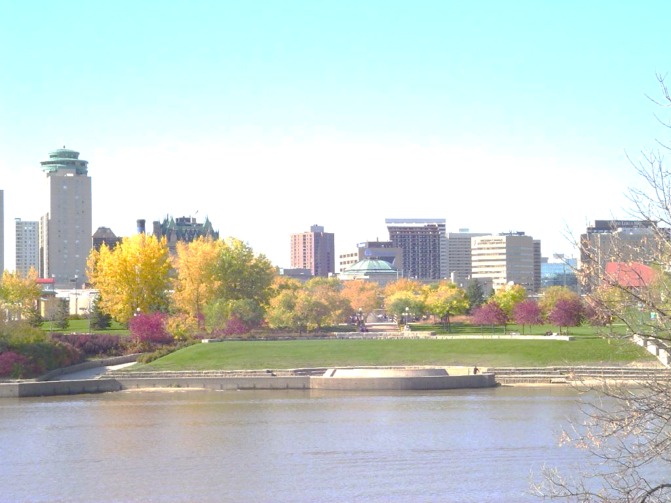


Applying a Health Lens to
Public Facility Design
Dr. Lisa Richards, Medical Officer of Health, Winnipeg Regional Health Authority
CPHA Conference, Toronto
May 28, 2014
Notes:
The focus of my presentation today is the journey our Winnipeg CLASP HCBD team has embarked on to influence public facility design in Winnipeg.
I have a visual here of downtown Winnipeg, and I can confirm that summer has finally arrived in Winnipeg over this past weekend!

Slide 2
CLASP Project Team
WRHA- Population and Public Health Program
  Deanna Betteridge- Physical Activity Promotion Manager
  Sarah Prowse- Acting Physical Activity Promotion Manger
  Shelagh Graham- Healthy Built Environment Specialist
  Dr. Lisa Richards- Medical Officer of Health
  Dr. Lawrence Elliott- Medical Director
City of Winnipeg- Planning, Property & Development
  Andrew Ross- Planner, Urban Planning Division
  Susanne Dewey-Povoledo- Planner
Notes:
I am presenting today on behalf of our CLASP Project team. As you can see, we have representatives from both the WRHA PPH Program and the City of Winnipeg- Planning, Property and Development department

Slide 3
Overview
Background
Objectives
Partnerships (4)
Tool: Active Design Checklist
Preliminary Findings
Reflections &Successes
Notes:
Start with some background on our CLASP HCBD Winnipeg initiative
Then provide an overview of the objectives of one of our projects, Applying a Health Lens to Public Facility Design
And tell you about some partnerships we have developed for this project
Introduce you to a tool we have developed- the Active Design Checklist for Public Facilities
Share our preliminary findings, as well as some reflections and successes to date

Slide 4
CLASP HCBD Winnipeg
City of Winnipeg staff
Social Planning Council ∙ MMM Group ∙ Province of Manitoba (Local Government; Healthy Living, Seniors & Consumer Affairs; Manitoba Health) ∙ University of Manitoba (City Planning; Office of Sustainability; Kinesiology & Recreation Management) ∙ Bike Winnipeg ∙ City of Winnipeg (Council; Public Works; Planning, Property & Development; Winnipeg Transit) ∙ Professional Interior Designers Institute of Manitoba ∙ Green Action Centre ∙ Heart & Stroke Foundation ∙ Health in Common ∙ Dillon Consulting ∙ WRHA (Chronic Disease Collaborative; Injury Prevention Program) ∙ University of Winnipeg (Kinesiology)
If you want to go fast,
go alone.
If you want to go far,
go together.
- African Proverb
Senior Management
University of Manitoba
Local stakeholders
Notes:
Very early consultation/engagement … diverse range or stakeholders
We have focused a lot of energy on our relationship with the CoW
We’ve engaged Sr Mgmt of both the WRHA and City of Winnipeg
We’ve been meeting regularly with the department head for City Planning at the U of M, and the CLASP initiative has even peaked the interest of the Dean of Architecture
Over the past year, we’ve talked to a wide range of local stakeholders illustrated on this slide that have informed our Action Plan.

Slide 5
Building Strategic Relationships
Supporting Research & Evaluation
Exploring Promising Practices
Building Sustainability
Notes:
Our vision is to integrate health into city planning processes in Winnipeg.
Three theme areas have emerged as local priorities:
We want to:
Build Strategic and Sustainable Relationships with organizations and groups that play a role in Winnipeg’s built environment.
Identify Promising Practices & Policies that support decision-making promoting physical activity.
Support Research & Evaluation by identifying data required to build the case for policy and practice change related to healthy built environment and physical activity.
Building the sustainability of our efforts in encouraging healthy built environments has been a consideration of our work throughout the initiative.

Slide 6
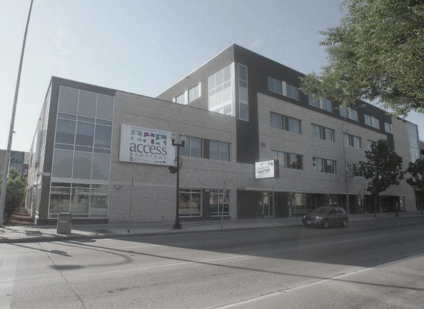
Applying a Health Lens to Public Facility Design
Notes:
Applying a Health Lens to Public Facility Design is one of four projects we have initiated that will explore ways that public facilities can be designed and oriented to maximize and encourage active access.

Slide 7
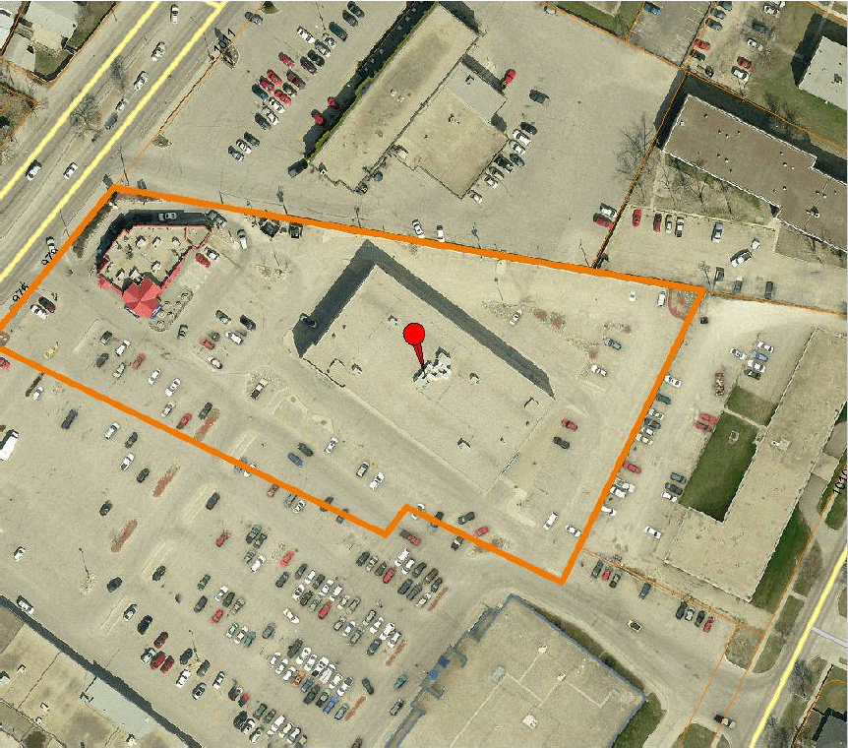
Issue Identification- WRHA Access Centers
Leading by Example?
Notes:
The seed for this project was planted when one of our City colleagues brought to our attention that many of our recent WRHA builds, including this one, were not meeting active design guidelines, and had relatively poor access for cyclists and pedestrians.
It became clear to us at that time that our own building practices can be improved on if we wanted to have credibility with our partners, and lead by example.
The facility offers services including:
• a Health Action Centre primary care clinic
• public health
• home care
• community mental health
• midwifery
• a healthy aging resource team
• dental clinic operated by the Faculty of Dentistry in cooperation with Winnipeg Regional Health Authority
• employment and income assistance
• supported living
• vocational rehabilitation
• children’s special services
• respite coordination
• childcare coordination
As well, Winnipeg Child and Family Services and several other social services will operate out of the building.

Slide 8
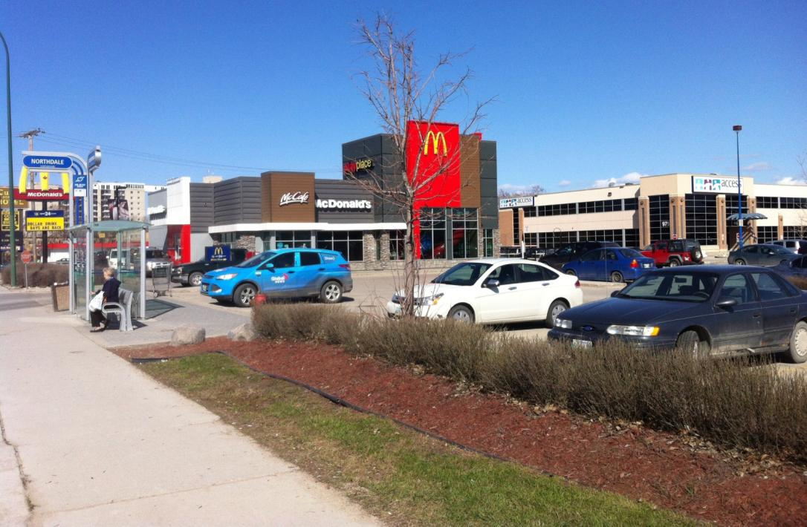
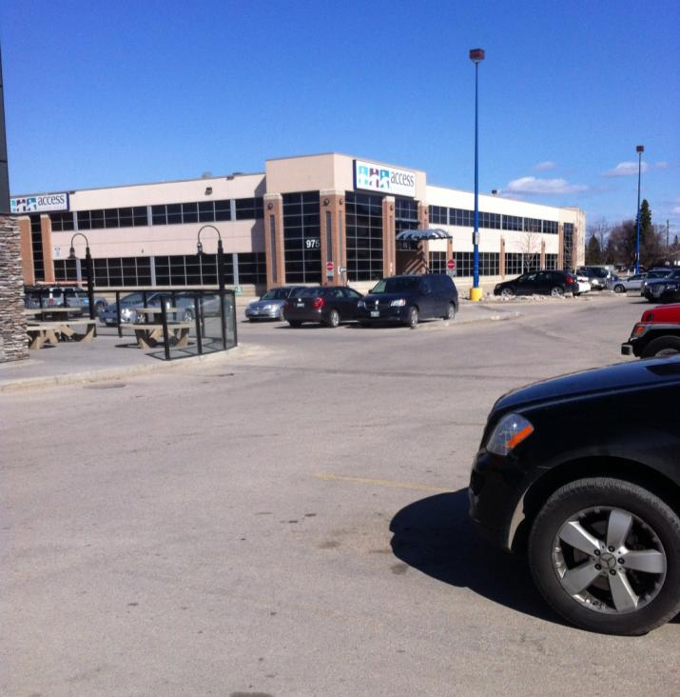
WRHA Access River East
Notes:
This slide illustrates some of the concerns with one of our Access Centers. Access Centers bring primary care, and a range of health services and social services into one location, making it easier for people to access the supports they need
This building is automobile oriented, in that it is set back from the street, and surrounded by surface parking lots.
On a side note: you clearly have to walk through a parking lot and a drive through to get to the Access Centre
No clear linkage between the building and any transit stops via pedestrian pathways, and no direct linkage to AT routes.
The facility offers services including:
• a Health Action Centre primary care clinic
• public health
• home care
• community mental health
• midwifery
• a healthy aging resource team
• dental clinic operated by the Faculty of Dentistry in cooperation with Winnipeg Regional Health Authority
• employment and income assistance
• supported living
• vocational rehabilitation
• children’s special services
• respite coordination
• childcare coordination
As well, Winnipeg Child and Family Services and several other social services will operate out of the building.

Slide 9
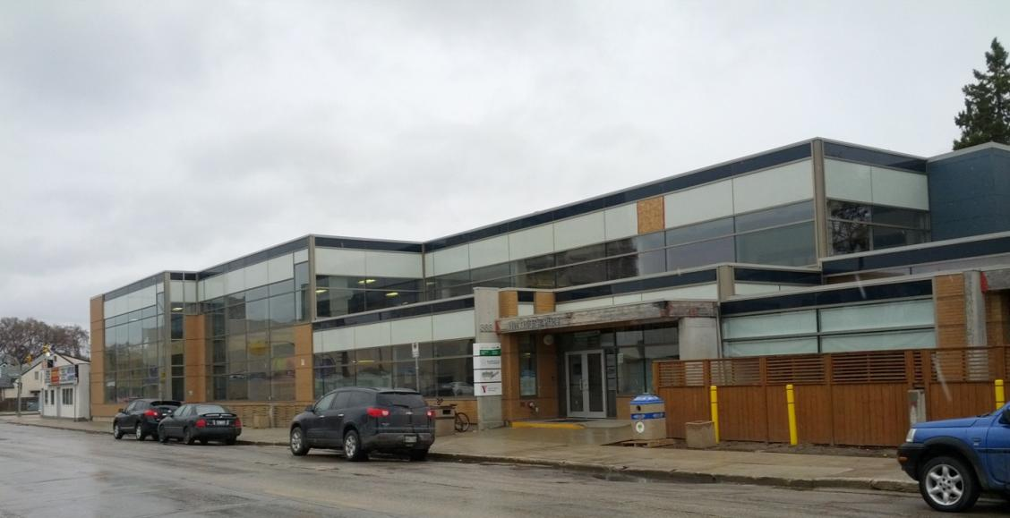
WRHA QuickCare Clinic
Notes:
Do have some successful examples- the QuickCare clinic illustrated here has a traditional storefront orientation in a mixed use corridor, and has a high degree of transparency visible from the public sidewalks close to pedestrian and AT routes

Slide 10
Project Outcomes- Short Term
To enhance the consideration of active design, collaboration mechanisms:
  Are established- between WRHA Population and Public Health and Capital Planning
  Are explored- between WRHA and City of Winnipeg
Increased awareness and understanding of opportunities and challenges of applying a health lens to public facility design.
Increased understanding of the points in decision-making processes where active access related decisions are made.
Notes:
One of our primary objectives for this project was to build relationships with key decision makers in our own organizations to try to influence our own public facility builds. For the WRHA, this has meant initiating a relationship with our Capital Planning division to insert a health lens. For the City of Winnipeg, this has meant starting a dialogue with decision makers there, facilitated by our City Planning colleagues.
Through these relationships, we strive to better understand the opportunities and challenges of applying a health lens to public facility design using a few case examples.
We also aim for a better understanding of the decision-making processes for new builds, and the points in the decision-making process where active access-related decisions are made

Slide 11
Project Outcomes- Long Term
The incorporation of a health lens into WRHA tendering and selection processes.
Potential consideration of practical planning process and policy amendments that support healthy and active community design.
Improvement of active design elements in public facilities.
Notes:
Longer term objectives included incorporating a health lens into WRHA tendering and selection processes. We had our VP’s support on achieving this.
Ultimately, we strive to influence the planning process for public facility builds in Winnipeg by providing a practical tool to insert into planning processes and policies, and thus improve active design elements in these public facilities.

Slide 12

Active Design Checklist for Public Facilities
Criteria to provide guidance for how to design public facilities in order to promote active access
http://www.cite7.org/resources/documents/ITERP-PromotingSustainableTransportationThroughSiteDesign.pdf
Notes:
I have mentioned the development of a tool associated with this project- it is the Active Design Checklist for Public Facilities
The checklist ensures priority is given to pedestrians, transit users, cyclists and those who require transportation services to get to the facility
This tool was based on the Canadian Institute of Transportation Engineer’s document “Promoting Sustainable Transportation Through Site Design”
The tool was cross-referenced to the City of Winnipeg’s planning documents, and
Reviewed with planners from the City’s Transportation Division (AT Coordinator, Engineers), Transit Division and their Universal Design Coordinator

Slide 13
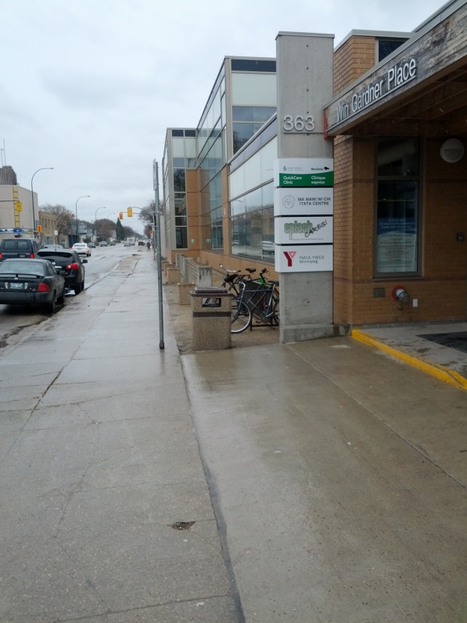
Active Design Checklist- Overview
Site Selection
Building Placement & Orientation
Site Design
Pedestrian Access & Amenities
Bicycle Access & Amenities
Building Design & Context
Notes:
Six sections of the Active Design Checklist, with multiple criteria for each section. So I will summarize just some of the key points:
1. Location is important to ensure easy access to the facility and its services for all users. Ideally the facility should be located in a mixed use center& building that is close to pedestrian and AT routes
2. Buildings that face the street support direct and easy access for all users. The building should be close to street, yet set far back enough to allow for pedestrian activities. Entrances should be located at or close to the sidewalk and no more than 400 m from a transit stop, and include a direct route for pedestrians
3. Site Design directly impacts on the ability of staff and users to access the facility through active means. Facilities should
Minimize points of conflict between vehicles and pedestrians/cyclists
Have Off street parking that is located away from the street (e.g. behind buildings) AND
Small parking lots with traffic calming and preferential parking for accessibility, car pool/share vehicles and bike parking in the most convenient area of the lot
4. Provision of universally accessible, safe, direct, continuous and clearly defined pedestrian routes
with crossings that are prominent and visible
5. Provision of safe, direct, continuous and clearly defined cycling routes and amenities, including sheltered bicycle parking at entrance with showers and locker facilities on site
6. Design of a street-oriented facility that supports multiple modes of transportation that is situated in an existing building with a traditional storefront orientation and consistent with the form and character of the local context

Slide 14
Partnerships
Winnipeg Regional Health Authority
City of Winnipeg
University of Manitoba
Reh-Fit Centre
Notes:
Once the Active Design Checklist was developed, we approached our own organizations to see if there were any new builds that the checklist could be applied to within the WRHA and City of Winnipeg. The University of Manitoba and Reh-Fit Center approached us, and expressed interest in participating in this project as well.

Slide 15
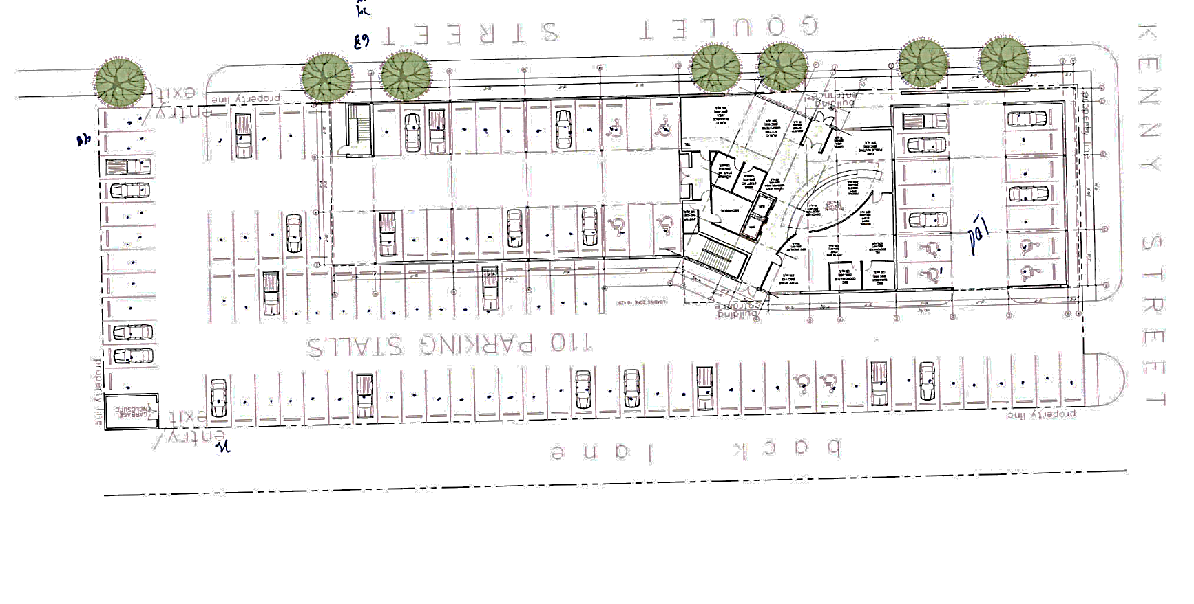
Winnipeg Regional Health Authority
“…an innovative way to deliver a range of health and social services to a community."
ACCESS St Boniface
Notes:
Access St Boniface is a new WRHA facility that has been approved for construction. The architect has been selected, and a site design has been proposed as illustrated. There may still be some opportunities to improve on active access, though

Slide 16
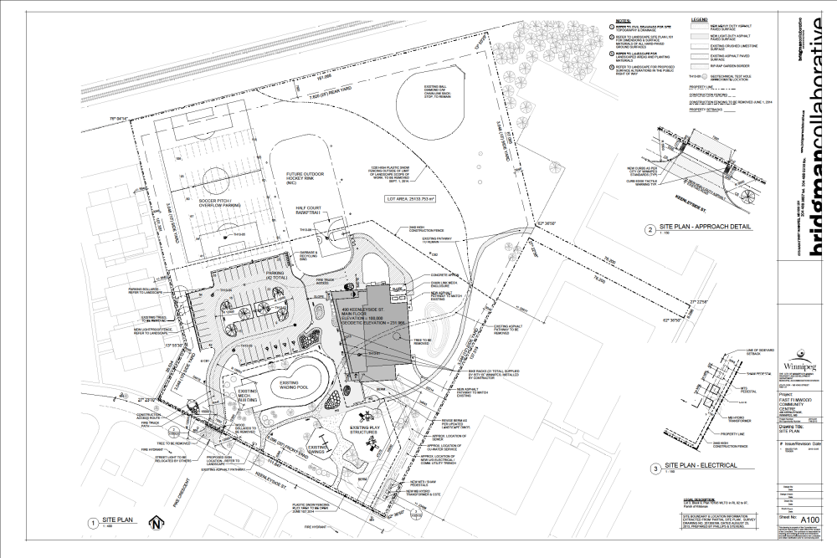
City of Winnipeg
East Elmwood Community Centre
“A new facility in an existing community place”
Notes:
The City of Winnipeg has begun construction on a new community center that has been built around some existing infrastructure, including a wading pool, sports fields and a playground. Like the WRHA Access Center, there are still some opportunities to influence its final design.

Slide 17
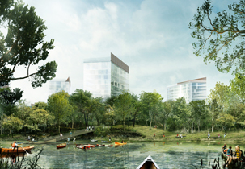
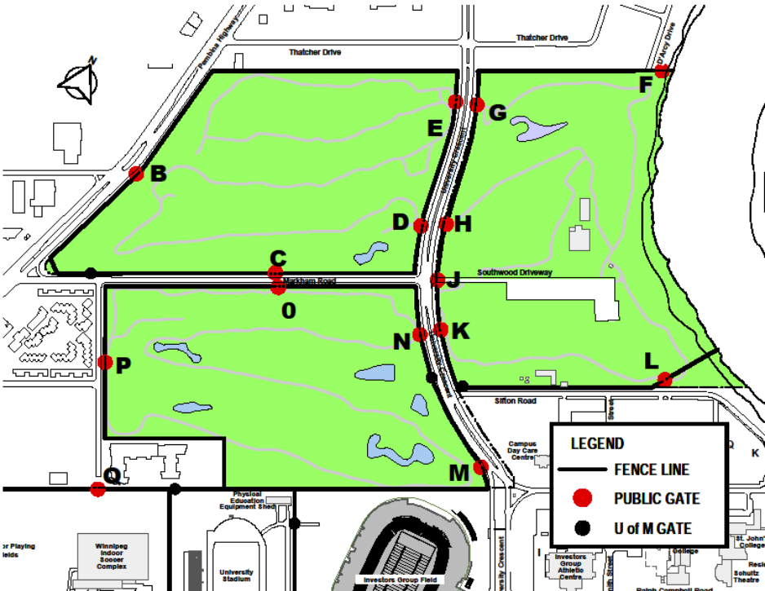
University of Manitoba
Southwood Lands
“… transforming the Fort Garry campus into a new, sustainable 24/7 ‘live, work, learn, play’ community”
http://www.visionaryregeneration.com/media/Southwood_Riverbanksm3.jpg
http://umanitoba.ca/admin/campus_planning_office/media/SW_Gate_Location_Map4_(FINAL).pdf
Notes:
The University of Manitoba has a 120 acre parcel of land owned by the university and being slated for development
The university sponsored an Open International Design Competition, with the objective of transforming the Fort Garry campus into a new, sustainable 24/7 “live, work, learn, play” community, with a focus on public space and ‘landscape first.’ They have selected a landscape architect from Toronto to lead the planning and design.

Slide 18
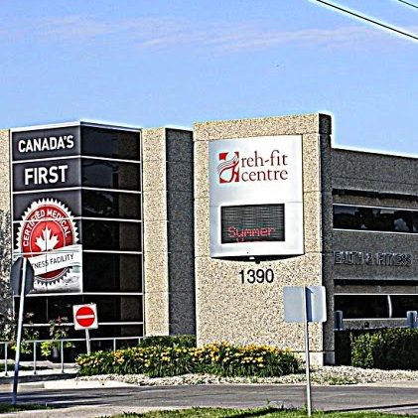
Reh-Fit Centre
Expanding and enhancing a well used medically-based fitness center
http://www.communitynewscommons.org/newstoyoueic/wp-content/uploads/2013/03/Reh-Fit-Centre-crop.jpg
Notes:
The Reh-Fit Center is a certified medical fitness facility that will be expanding to accommodate a growing client-base, including space for more exercise equipment and lockers, and perhaps a swimming pool.

Slide 19
Key Informant Interviews
Current processes and tools used for new builds?
Active Design Checklist
  Utility of the checklist?
  Criteria that were easy/a challenge to consider or incorporate?
  Criteria that prompted you to plan your facility differently?
Opportunities for integrating the checklist criteria into existing processes and tools?
Notes:
We conducted a preliminary interview of our key contact from each of our 4 partners to better understand:
Their current process for designing new public facilities, including the tools they use (if any)
Their overall impressions of the Active Design Checklist for Public Facilities; specifically:
How user-friendly the checklist is
The criteria that were easy to consider or incorporate, as well as those that were challenging
And any criteria that may prompt a modification to the design of the facility
As well, we wanted to know if they felt there were opportunities to integrate the checklist criteria into their existing planning processes and tools
Utility of the checklist in its current form for influencing planning and design considerations for public facilities?
Areas of challenge in using the checklist and opportunities for improvements?
Opportunities of integrating the checklist or elements of it into existing planning and design decision making tools (e.g. RFP requirements, RFP evaluation criteria, design specifications, etc.)?
Were you able to use the checklist for your project?
If not, please explain the barrier(s) you encountered.
If yes, at which planning or design decision point(s) did you use it (site selection, building orientation, site layout, building design, other)?
Which sections or individual criteria were easy/challenging to consider?
For those that may have been more challenging, why were they challenging?
Do you have any suggestions on how these challenges could be overcome?
Did any part of the checklist prompt you to make a planning of design decision differently than normal?
If so, please explain.
At which stage of your existing processes are decisions made about the following: site selection, building placement and orientation, site design and layout, pedestrian access/amenities, cycling access/amenities, building design and context?
What opportunities exist to incorporate elements of the checklist in your existing decision-making tools?
Can you imagine any other uses for this checklist?
What other tools/criteria (if any) have been used to guide the planning for your previous public facility builds?
Are there any specific suggestions for modifications or additions to the checklist to make it more useful for your needs and/or user-friendly?
Would you be interested in another checklist section on how the design and use of the interior of the building supports opportunities physical activity / active access (e.g., placement of stairs/elevators, point of decision prompts, size of boardrooms)?

Slide 20
Preliminary Findings:
1. Current Considerations and Tools
Site Selection, Design and Layout
Building Design and Layout
Pedestrian and Bicycle Access/Amenities
Notes:
Moving onto our findings to date…
In terms of our partners current processes and tools used for a new public facility build:
Their Site Selection, Design and Layout
Is guided by specific considerations:
For WRHA’s new Access Center build, for example, a central location within the community area was a deciding factor
For the City of Winnipeg community center build, the selection of a location best fit around existing infrastructure
For the U of M, building rehabilitation/reuse is a preferred approach where appropriate
Interestingly, we have uncovered that parking stalls are quite expensive to build- we think this is an opportunity to influence the use of car shares and expanded bike parking
For Building Design and Layout
There is typically adoption of one or more guidelines, such as LEED Silver and the Universal Design Guidelines
We also heard that architects are assumed to be following current guidelines supporting active access, and that decision-makers are typically accepting design proposals under this assumption
For Pedestrian and Bicycle Access/Amenities
Universal accessibility is prominent consideration and
Bicycle amenities are often incorporated as part of LEED requirements

Slide 21
Preliminary Findings:
2. Active Design Checklist
Some criteria are already incorporated; others will be a challenge
Illustrations could be helpful
Expansion of checklist- building interior
Notes:
Regarding our feedback to date on the active design checklist:
Some criteria are already incorporated into existing planning tools or processes (e.g. bike parking, universal accessibility) BUT
Others will clearly be harder to incorporate (e.g. building character and context)
Illustrations could be included
Expansion of checklist to include design of the building interior (e.g. placement of stairs/elevators, point of decision prompts, size of boardrooms)

Slide 22
Preliminary Findings:
3. Integration of Checklist into Planning Tools
Opportunity to apply select criteria at:
  RFP stage
  Selection stage
Also- policy development, audits, prioritization of capital improvements
Benefit as a stand alone tool for decision-makers
Notes:
Our partners felt there was an opportunity to apply select checklist criteria at:
The RFP stage- this could be a separate schedule or included within the Outline Specifications
The selection stage could also utilize checklist components for scoring criteria
Most partners would incorporate components of the checklist only
As well, we were told that the checklist could be used for policy development, audits, and prioritization of capital improvements
It also was felt to have benefit as a stand alone tool for decision-makers

Slide 23
Reflections…
Site selection, design and layout- extremely important but not always prioritized
Parking stall expense is an opportunity!
Loved the checklist… but harder to incorporate into current processes
Introduced checklist at later stages of development- limited opportunity for change
Bureaucratic realities (e.g. funding delays)
Benefit of internal champion as “agent of change”
Notes:
With less parking stalls required, a smaller site could be targeted, a car share could be considered, and more bike parking could be allocated instead
Our partners loved the checklist, but the process for incorporating it into current processes did not seem so straight forward, especially the entire checklist as is
For some of our partners, the checklist was being introduced at later stages of their project, so the opportunities for change were limited
There are bureaucratic realities to deal with, such as funding delays that halts the development, that have been a challenge when you are working on a timeline
Finally, we have found that a few internal champions, such as our VP and the City planners we work with, to be invaluable as agents of change.

Slide 24
Successes to Date
Education of key decision makers
Better understanding process and tools for decision making
Refinement of Active Design Checklist
Insight into challenges of applying certain checklist criteria
Developed relationships within our own organizations, and identified opportunities to influence policy change
Notes:
Educated key decision makers among our partners about key aspects of active design
We have a better understanding of their process and tools for decision making at various stages of development
Continue to refine the Active Design Checklist to better meet the needs of our partners, and have
Gained insight into challenges of applying certain checklist criteria
Very importantly, relationships with key decision makers within our own organizations have been established and we have
Identified some opportunities to influence policy change at the RFP and selection stages within the WRHA

Slide 25
Contact Information:
Dr. Lisa Richards, Medical Officer of Health
lrichards@wrha.mb.ca 204-612-1581, Winnipeg, Manitoba

