Slide 1

Walking to transit
(and potential of walking)
Pr Catherine Morency, P.Eng., Ph.D.
Head of Mobilité research Chair
Polytechnique Montreal
www.polymtl.ca/mobilite
cmorency@polymtl.ca

Slide 2
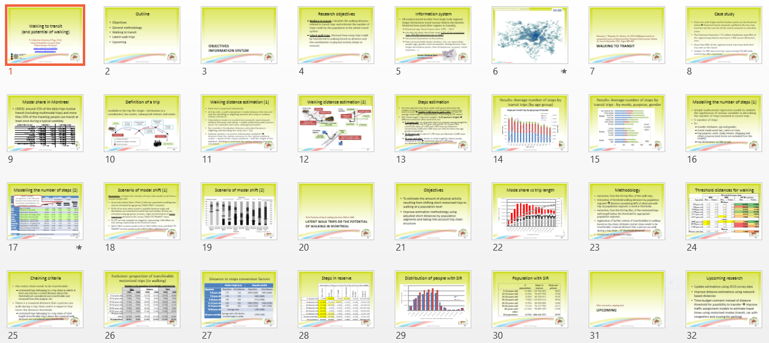
Outline
Objectives, information system
Walking to transit = steps
Potential of walking
Upcoming research

Slide 3
Objectives
Information system

Slide 4
Research objectives
  Walking to transit: Calculate the walking distance related to transit trips and estimate the number of steps made by the population in the whole transit system
  Potential of walking: Measure how many motorized trips could be transferred to walking based on distance and the contribution of this transfert to the amount of physical activity (measured using Steps in reserve)

Slide 5
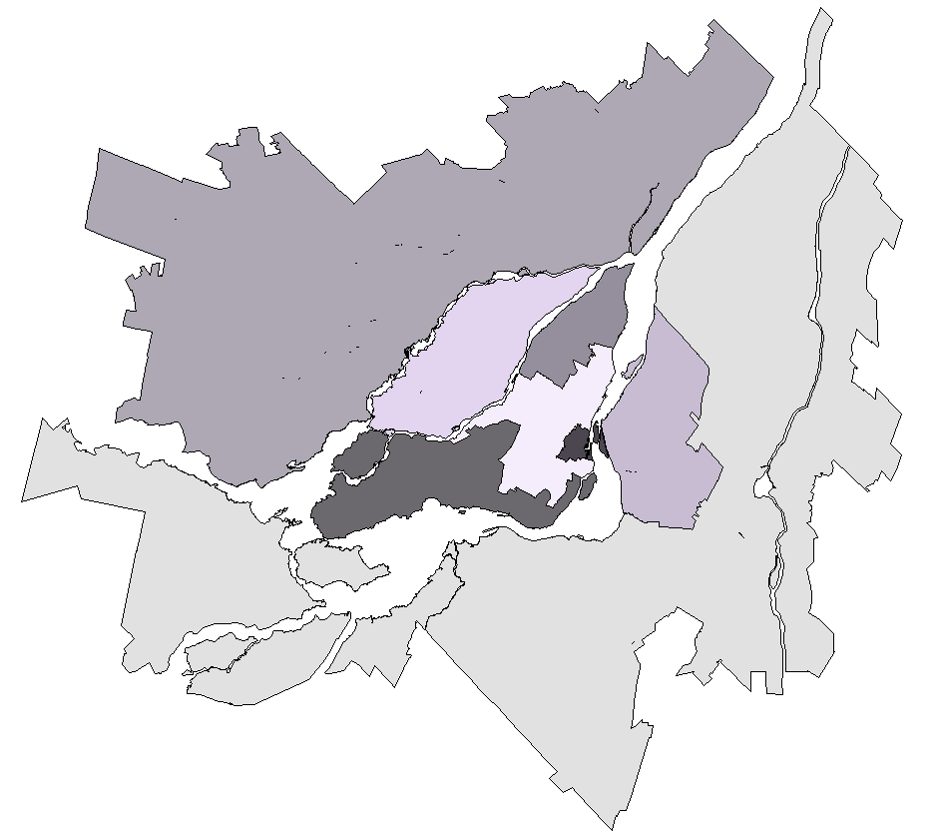
Information system
Analysis based on data from large-scale regional Origin-Destination travel surveys held in the Greater Montreal Area (and other regions in Canada);
  Montreal: app. Every 5 years since 1970 … 2013
  one day trip diary, data from some 4-5% of the population (app. 350 000 observed trips in 2008)
  Fall period (September to December)
  Data on households (home location, size, car ownership), people (age, gender, main occupation, driving license), trips (origin-destination points, time of departure, purpose, mode sequence, …)
Greater Montreal Area
3.6 Million people

Slide 6
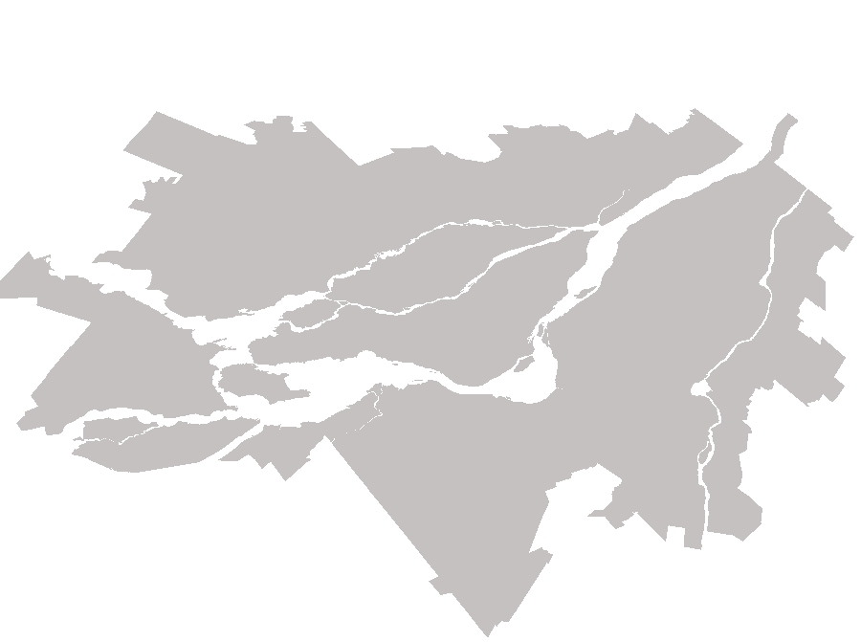
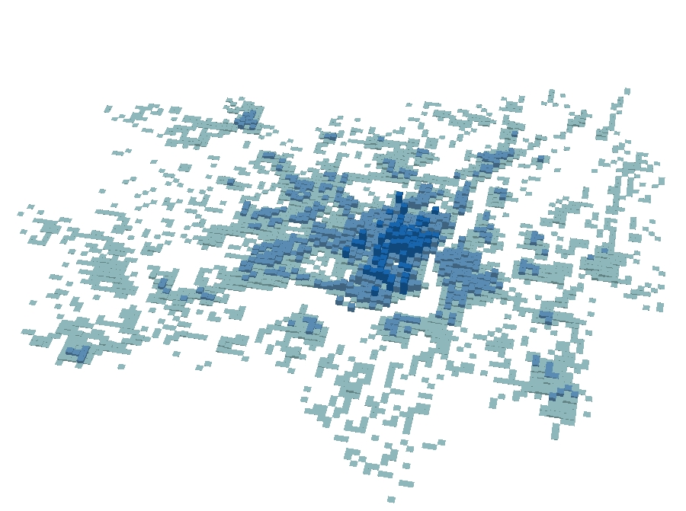
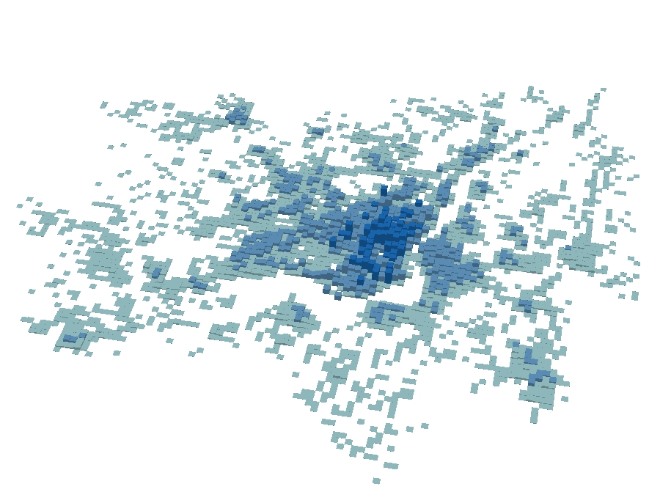
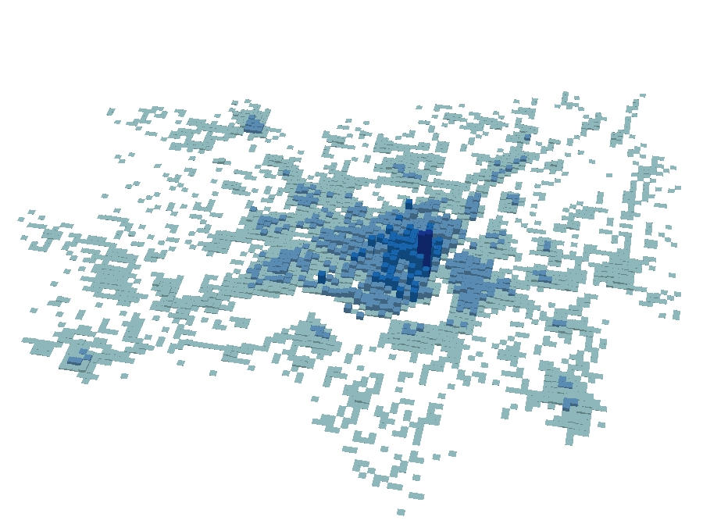
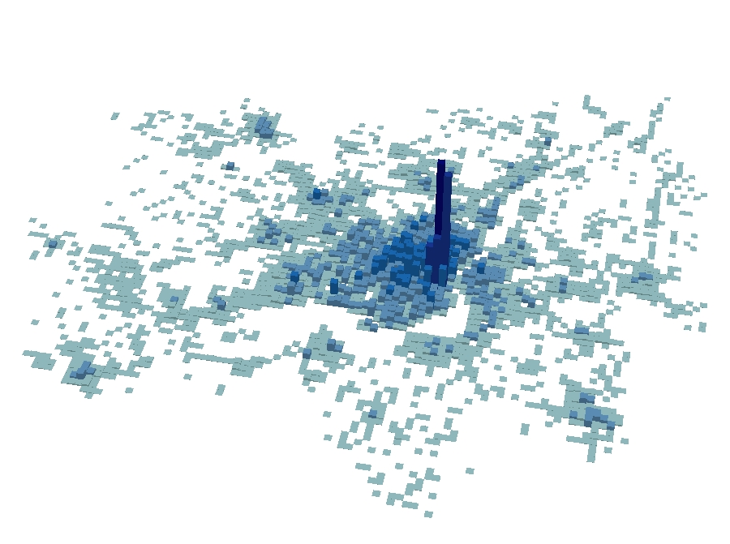
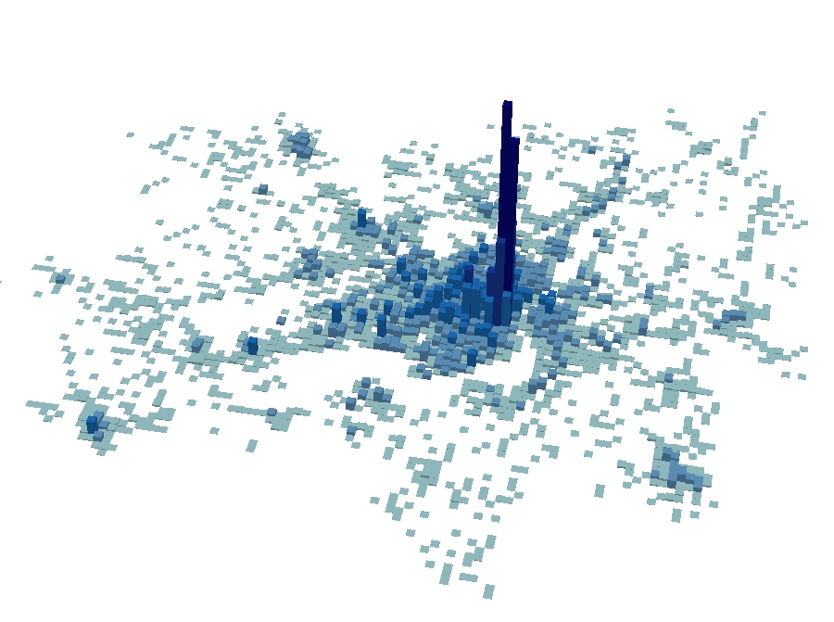
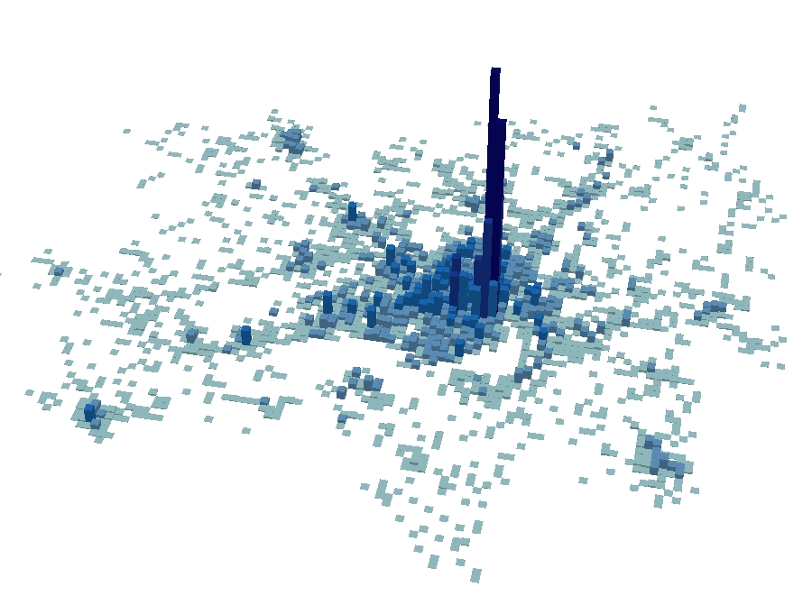

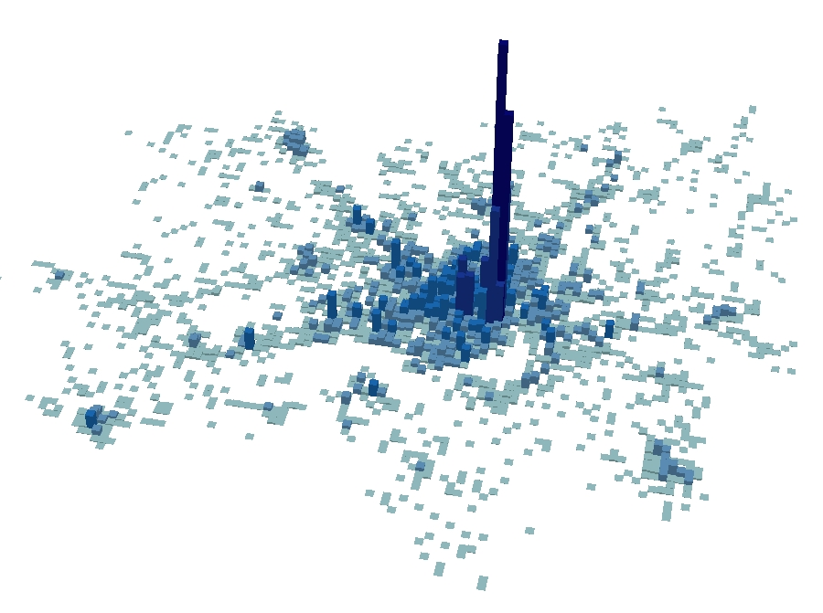
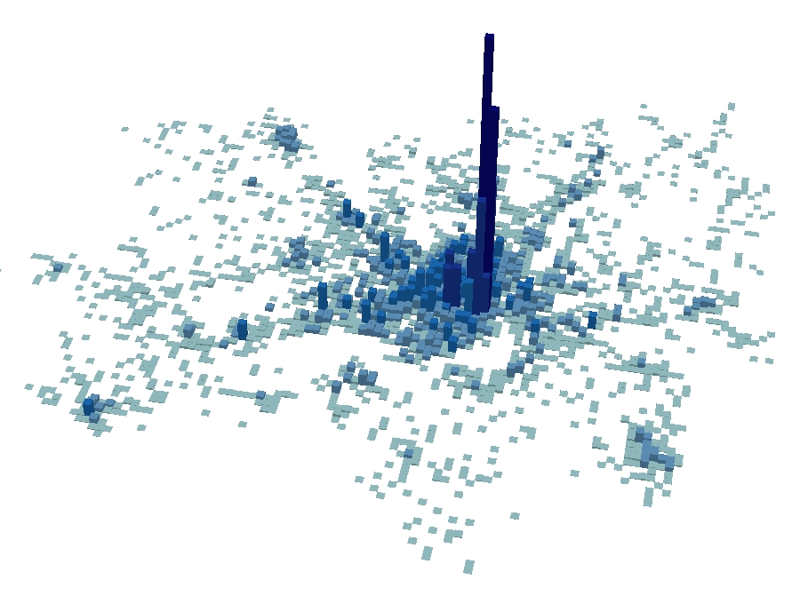


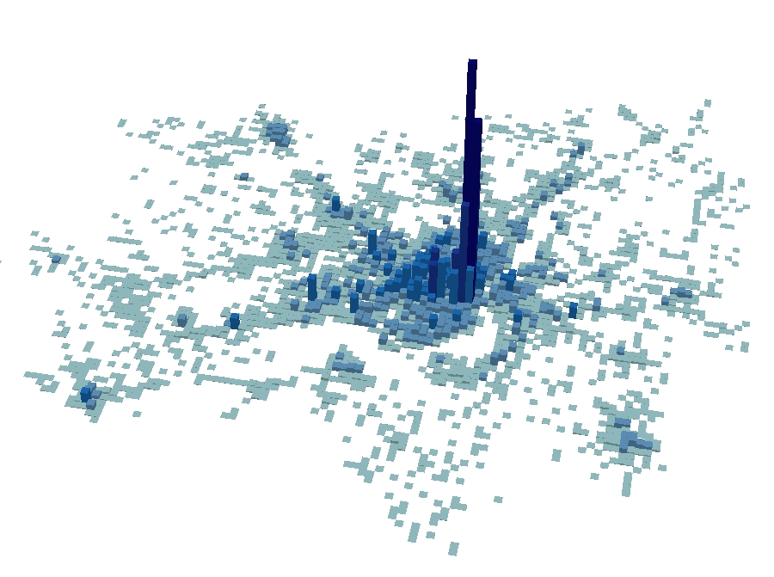
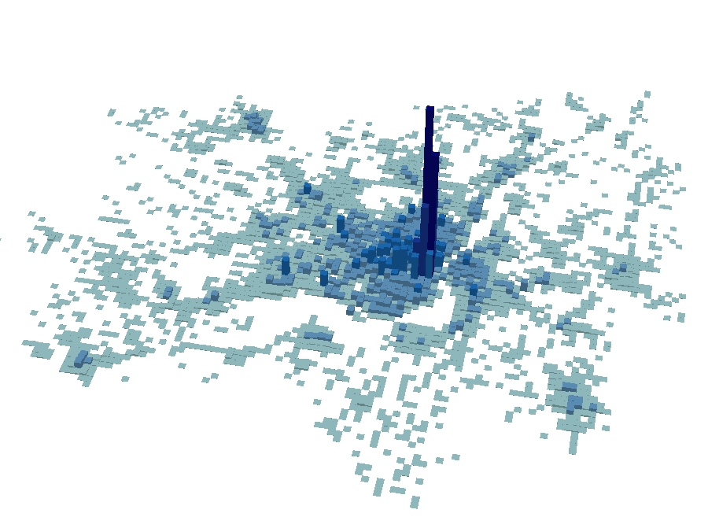
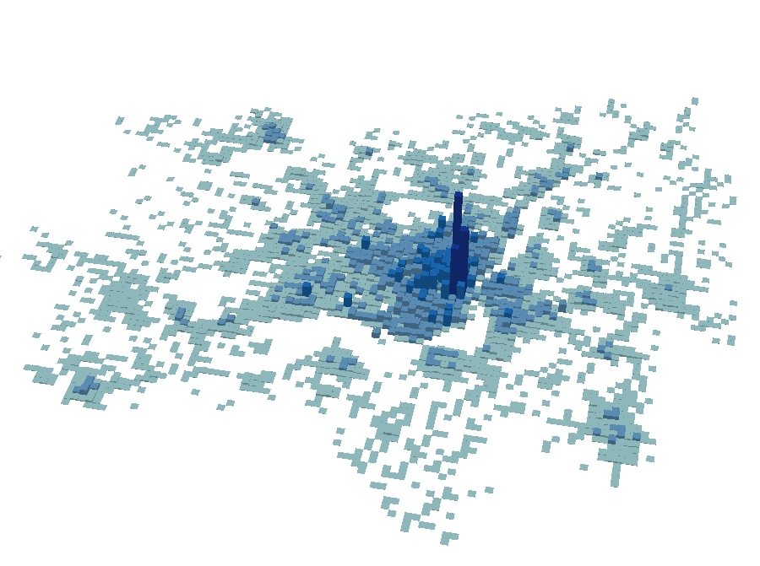



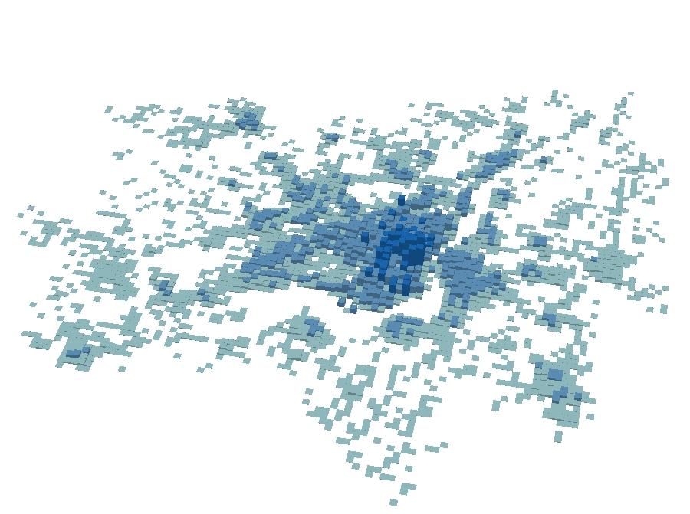


Migrations quotidiennes en 2003
05:00
06:00
07:00
08:00
09:00
10:00
11:00
12:00
13:00
14:00
15:00
16:00
17:00
18:00
19:00
20:00
21:00
22:00
23:00
24:00

Slide 7
Walking to transit
Morency, C., Trépanier, M., Demers, M. (2011) Walking to transit: an unexpected source of physical activity, Transport Policy Journal, Volume 18, Issue 6, November 2011, Pages 800–806

Slide 8
Case study
Only trips with Origin and Destination points on the Montreal Island → Montreal transit networks codified at the bus stop level but not the case for all the transit networks in suburban areas.
The Montreal Island has 1.71 million inhabitants (app.50% of the regional population) and covers a 500 square kilometers area.
More than 80% of the regional transit trips have both their trip ends on the Island.
Sample: 31 950 observed trips representing 918,000 daily transit trips after expansion

Slide 9
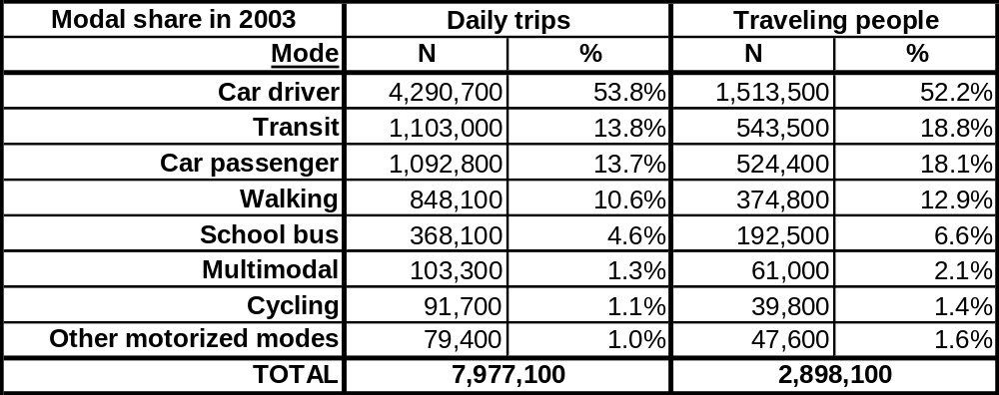
Modal share in Montreal
(2003): around 15% of the daily trips involve transit (including multimodal trips) and more than 20% of the traveling people use transit at least once during a typical weekday

Slide 10
Definition of a trip
Available in the trip file: Origin - Destination (x-y coordinates), bus routes, subway/rail stations and routes

Slide 11
Walking distance estimation (1)
Each trip is examined individually.
At trip ends, a path calculation is made between the trip end and the boarding or alighting location (bus stop or subway station entrance).
Calculations made on a pedestrian network: road network without freeways and ramps + public pedestrian paths (across parks, for example) and some underground paths.
Bus transfers: Manhattan distance calculated between alighting and boarding bus stops (Δx + Δy).
Subway stations: no precise information available! → distance from the station entrance to the station platform center + depth of the station platform + half the length of the platform. Walking to and from the station entrance also calculated.

Slide 12
Walking distance estimation (2)

Slide 13
Steps estimation
Very few attempts have been made until now to determine the number of steps required to cover a specific distance! Consensus seems to exist → roughly 2,000 steps to walk a mile (4.6 km) SO average stride length is approximately 2.5 feet long (0.762 meter)
BUT, Stride length = f(person’s height) = 0.42 (person’s height) → different conversion ratios need to be use.
  5-14 years old: use of growth charts to estimate average height for two age groups, the 5-9 years old and the 10-14 years old; conversion ratios of 1,875 and 1,565 steps per kilometer (respectively 3,000 and 2,500 steps per mile) for these two age groups respectively.
  15-64 years old: A ratio of 1,250 steps per kilometer (2,000 steps per mile)
  65 years and older: decline in stride length for elderly people, estimated at 10% → conversion ratio of 1,375 steps
  per kilometer (2,200 steps per mile).

Slide 14
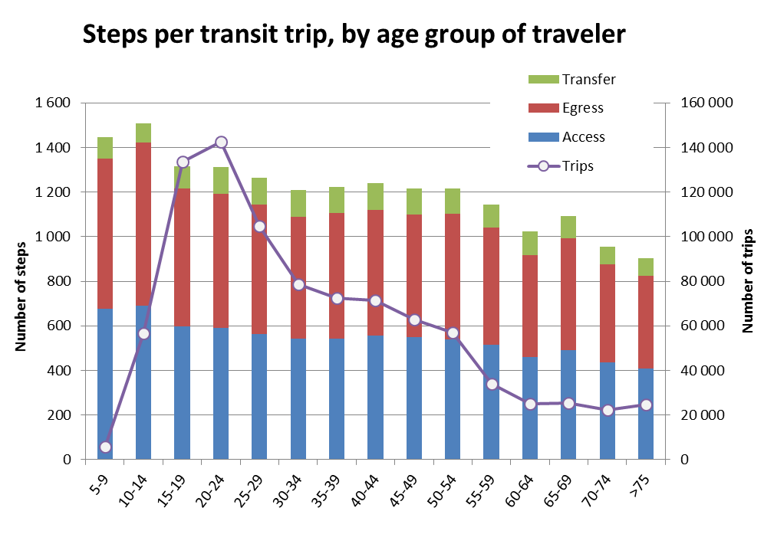
Results: Average number of steps by transit trips (by age group)
Age group

Slide 15
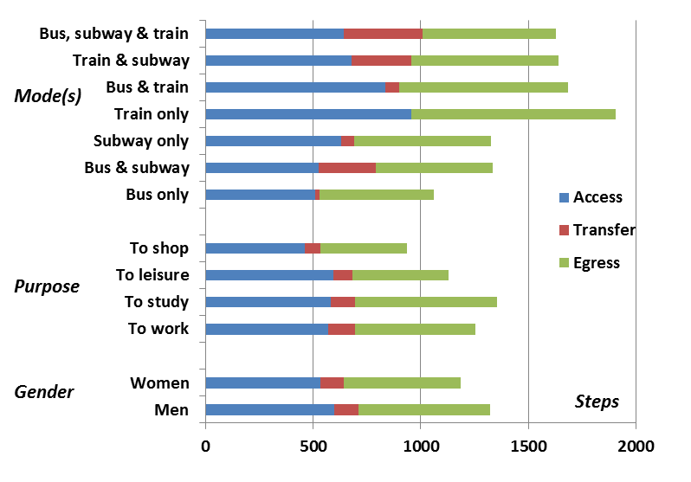
Results: Average number of steps by transit trips : by mode, purpose, gender

Slide 16
Modelling the number of steps (1)
Simple multivariate regression model to validate the significance of various variables in describing the number of steps involved in transit trips
Y: number of steps
Xs:
  traveler attributes: age and gender;
  transit mode used: bus, metro or train;
  trip purpose: work, study, leisure, shopping and others (journey back home are excluded from the model);
  trip destination: to CBD or not.

Slide 17
Modelling the number of steps (2)
All the variables
are significant at the 99% level. However, the model itself does not perform well. Relations are nevertheless confirmed.
 | Number of observations | 17257 | F( 10, 17246) |  | 116.25
 |  |  | R-squared |  | 0.069
Variable | Description | Coefficient | t | Average Value | Standard deviation | Average impact (steps)
Age | Age of traveller | -1.67 | -3.47 | 34.06 | 16.52 | -56.91
Men | Traveler is a men (1/0) | 91.82 | 6.88 | 0.44 | 0.50 | 40.02
Bus | Trip involves the bus (1/0) | -36.89 | -2.37 | 0.68 | 0.47 | -24.94
Subway | Trip involves the subway (1/0) | 271.19 | 16.34 | 0.60 | 0.49 | 163.45
Train | Trip involves the train (1/0) | 709.10 | 17.32 | 0.05 | 0.22 | 34.68
Study | Trip purpose = study (1/0) | 72.04 | 4.02 | 0.30 | 0.456 | 21.66
Leisure | Trip purpose = leisure (1/0) | -94.82 | -4.02 | 0.11 | 0.31 | -10.35
Shopping | Trip purpose = shopping (1/0) | -206.00 | -9.20 | 0.09 | 0.28 | -17.51
Other p. | Trip purpose = other (1/0) | -193.28 | -8.05 | 0.09 | 0.28 | -16.50
To CBD | Trip destination in CBD (1/0) | -183.49 | -12.85 | 0.37 | 0.48 | -67.70
Constant | Constant of the model | 1166.22 | 39.50 |  |  | 1166.22
Average | (steps per transit trip) - excluding trips back home |  |  |  |  | 1232.12

Slide 18
Scenario of modal shift (1)
Illustration: estimate the number of steps that would result from a certain modal shift
A) car trips shorter than 1.6 km (1 mile) are converted to walking trips and are estimated by age group ("WALK ONLY“ scenario);
B) 5% of car trips where transit is available between origin and destination are converted to transit trips and number of steps are estimated using age group, purpose, origin and destination of similar transit trips declared in the survey ("WALK TO TRANSIT“ trips).
51,472 car trips (sample) are targeted, representing 1,08 million car trips during a typical day on the Montreal Island.
WALK ONLY scenario would result in 246.6 million steps and WALK TO TRANSIT scenario would result in 56.8 million additional steps.

Slide 19
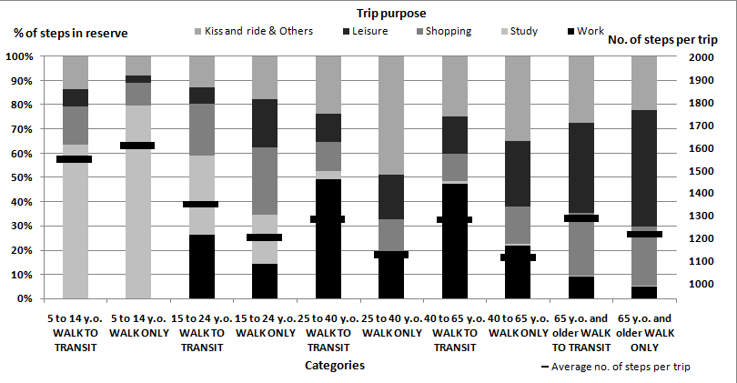
Scenario of modal shift (2)

Slide 20
potential of walking in Montreal
2014: Evolution of latent walking trips from 2003 to 2008

Slide 21
Objectives
To estimate the amount of physical activity resulting from shifting short motorized trips to walking at a population level
Improve estimation methodology using adjusted short distances by population segments and taking into account trip chain structure

Slide 22
Mode share vs trip length

Slide 23
Methodology
Extraction, from the OD trip files, of the walk trips;
Estimation of threshold walking distances by population segment → distance cumulating 80% of observed walk trip, by population segment, is used as threshold;
Extraction, from the OD trip files, of the motorized trips with length below the threshold for appropriate population segment;
Application of further criteria of transferability to walking based on trip chain attributes (entire chain needs to be transferable, maximal distance that a person can walk during a trip chain = 4* threshold distance)
Conversion of distance to steps.

Slide 24
Threshold distances for walking
 | Threshold distances (km)
 | 2003 |  | 2008 |  | '03-'08 evolution
Age group | Men | Women | Men | Women | Men | Women
Children
5-6 years old | 0.71 | 0.70 | 0.83 | 0.81 | 16.65% | 16.32%
7-8 years old | 0.77 | 0.75 | 0.77 | 0.86 | -0.84% | 14.60%
9-10 years old | 0.82 | 0.82 | 0.89 | 0.87 | 9.37% | 6.16%
11-12 years old | 0.96 | 0.97 | 1.09 | 1.09 | 13.37% | 12.18%
13-14 years old | 1.36 | 1.37 | 1.44 | 1.50 | 6.21% | 9.25%
15-17 years old | 1.53 | 1.43 | 1.60 | 1.54 | 4.26% | 7.51%
Adults
18-24 years old | 1.73 | 1.43 | 1.82 | 1.68 | 4.98% | 17.28%
25-40 years old | 1.60 | 1.31 | 1.54 | 1.42 | -3.91% | 7.89%
41-64 years old | 1.51 | 1.38 | 1.45 | 1.40 | -3.83% | 1.87%
Elderly
65 years and older | 1.27 | 1.17 | 1.33 | 1.18 | 4.36% | 0.96%

Slide 25
Chaining criteria
The entire chain needs to be transferable:
  motorized trips belonging to a trip chain in which at least one trip has a travel distance above the threshold are considered non transferable and removed from the analysis set.
There is a maximal distance that a person can walk during a trip chain and it is equal to four times the distance threshold:
  motorized trips belonging to a trip chain of total length (transferable trips) above this maximal walk distance are considered non transferable.

Slide 26
Evolution: proportion of transferable motorized trips (to walking)
 | Evolution in the proportion of transferable motorized trips
 | Men |  | Women |  | Total
 | 2003 | 2008 | 2003 | 2008 | 2003 | 2008
5-14 years old | 13.5% | 13.4% | 14.1% | 14.2% | 13.7% | 13.8%
15-24 years old | 7.8% | 7.2% | 7.2% | 6.9% | 7.5% | 7.0%
25-34 years old | 9.2% | 6.8% | 10.9% | 10.0% | 10.0% | 8.4%
35-44 years old | 11.1% | 9.5% | 14.2% | 12.6% | 12.7% | 11.1%
45-54 years old | 9.5% | 8.0% | 10.3% | 9.1% | 9.9% | 8.5%
55-64 years old | 11.2% | 9.6% | 12.4% | 11.8% | 11.8% | 10.7%
65 years and older | 14.3% | 14.6% | 15.1% | 14.2% | 14.7% | 14.4%
All population | 10.6% | 9.4% | 11.9% | 11.0% | 11.2% | 10.2%

Slide 27
Distance to steps conversion factors
 | Median height (cm) |  | Steps/km (/mile)
Age group | Boys/Men | Girls/Women | Boys/Men | Girls/Women
5-6 years old | 117 | 116 | 2035 (3280) | 2053 (3300)
7-8 years old | 128 | 128 | 1860 (3000)
9-10 years old | 139 | 139 | 1713 (2760)
11-12 years old | 149 | 154 | 1598 (2570) | 1546 (2490)
13-14 years old | 165 | 163 | 1443 (2320) | 1461 (2350)
15-64 years old | Average ratio |  | 1250 (2000)
65 years and older | Average ratio: 10% decline in stride length vs adults |  | 1375 (2200)
Growth charts (Tanner and Davies, 1985)

Slide 28
Steps in reserve
 | Distribution of steps in reserve from the various modes (2008)
 | %Car driver | % Car passenger | % Transit | % School bus | % Other modes | Steps in reserve
5-14 years old | 0.00% | 68.88% | 5.25% | 25.45% | 0.41% | 110 740 904
15-24 years old | 43.88% | 20.31% | 28.87% | 6.16% | 0.78% | 78 047 796
25-34 years old | 77.36% | 11.47% | 9.60% | 0.00% | 1.58% | 68 748 522
35-44 years old | 86.74% | 6.67% | 5.97% | 0.00% | 0.61% | 110 926 314
45-54 years old | 84.62% | 9.45% | 5.18% | 0.00% | 0.74% | 88 895 666
55-64 years old | 78.12% | 13.93% | 7.30% | 0.00% | 0.64% | 74 417 790
65 years and older | 69.16% | 18.24% | 10.86% | 0.00% | 1.74% | 76 667 379
All population | 60.82% | 23.04% | 9.85% | 5.42% | 0.87% | 608 444 372

Slide 29
Distribution of people with SIR

Slide 30
Population with SIR
 | % population | Steps in reserve | Steps per person
5-14 years old | 12.06% | 110 740 904 | 2082
15-24 years old | 6.47% | 78 047 796 | 2748
25-34 years old | 5.87% | 68 748 522 | 2515
35-44 years old | 7.93% | 110 926 314 | 2594
45-54 years old | 6.79% | 88 895 666 | 2460
55-64 years old | 9.12% | 74 417 790 | 2321
65 years and older | 11.92% | 76 667 379 | 2139
All population | 8.33% | 608 444 372 | 2379

Slide 31
Upcoming
Other researches, ongoing work

Slide 32
Upcoming research
Update estimations using 2013 survey data
Improve distance estimations using network-based distances
Time-budget contraint instead of distance threshold for possibility to transfer → improve traffic assignment models to estimate travel times using motorised modes (transit, car with congestion and crusing for parking)

Slide 33
References
Morency, C., Trépanier, M., Demers, M. (2011) Walking to transit: an unexpected source of physical activity, Transport Policy Journal,, Available online 26 May 2011
Morency, C., Demers, M., Lapierre, L. (2008) How Many Steps Do You Have in Reserve? Some Thoughts and Measures About a Healthier Way to Travel, Transportation Research Record, Journal of the Transportation Research Board, No. 2002, pp.1-6., Washington D.C.
Morency, C., Roorda, M., Demers, M. (2009). Steps in Reserve: Comparing Latent Walk Trips in Toronto and Montreal. Transportation Research Record, Journal of the Transportation Research Board, no. 2140, pp.111-119, 2009
Morency, C., Demers, M. (2010). The "steps in reserve": An unexploited way to make our children more active during their daily routine, Child: Health, Care and Development, Volume 36, Issue 3, May 2010, Pages: 421–427.
Other paper in revision : Shifting short motorized trips to walking: the potential of active transportation for physical activity in Montreal

Slide 34




www.polymtl.ca/mobilite

